Slide 1
Getting Started in
VHF Roving
Bruce Richardson, W9FZ

Slide 2
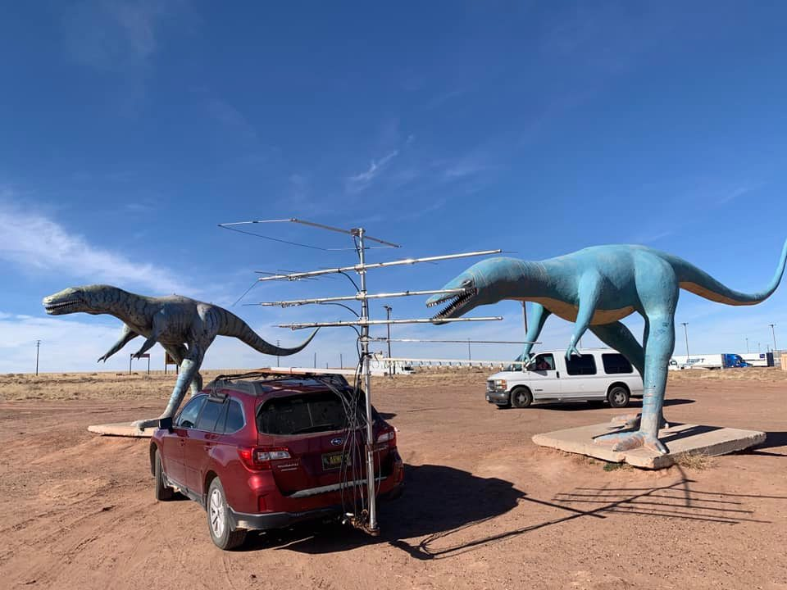
KK6MC/R in New Mexico

Slide 3
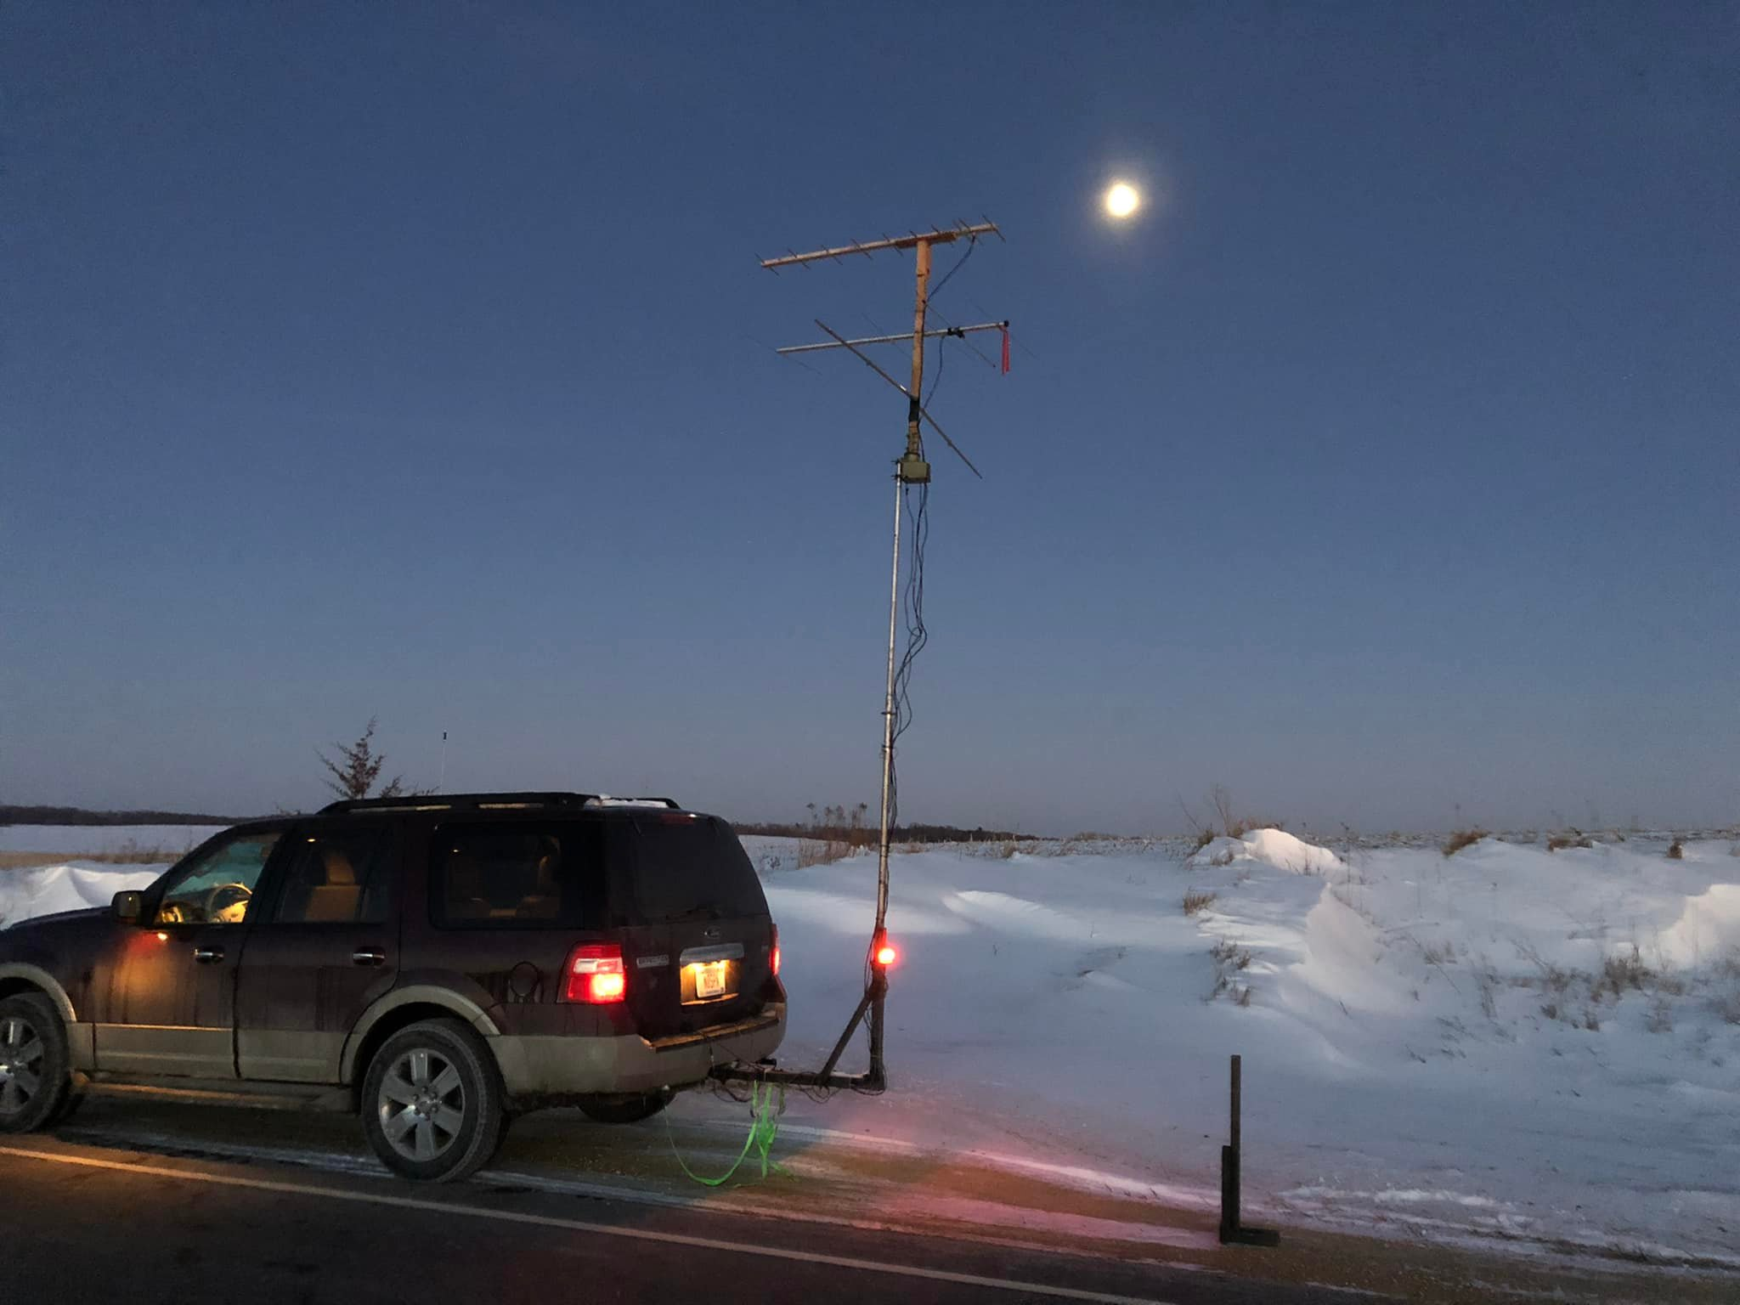
Danny, N0SPN/R
Near Rochester, MN

Slide 4
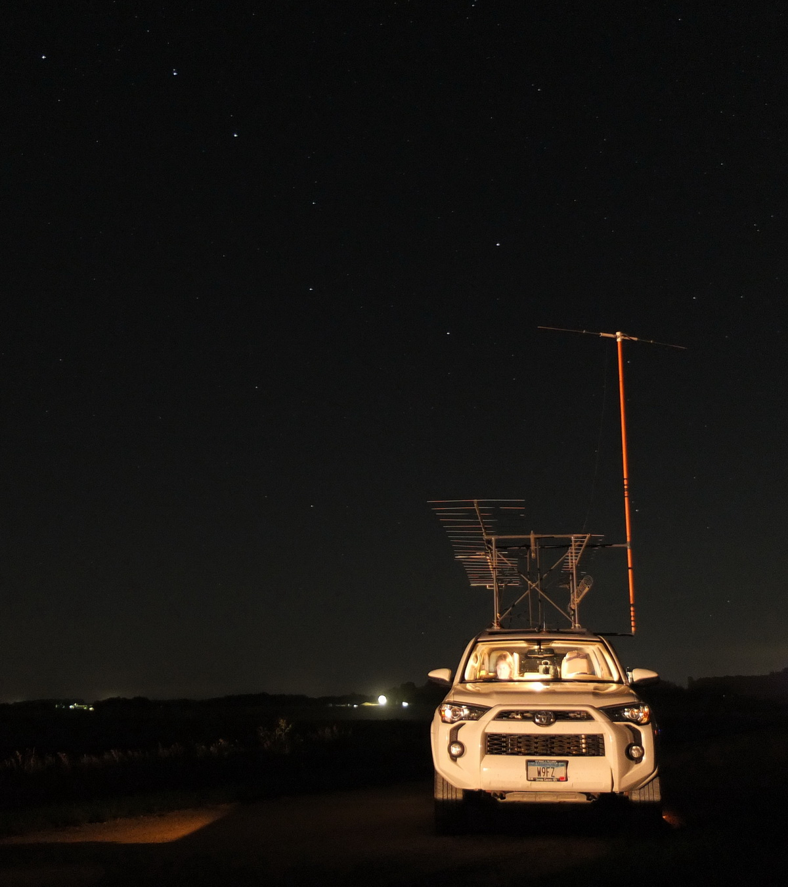

Slide 5
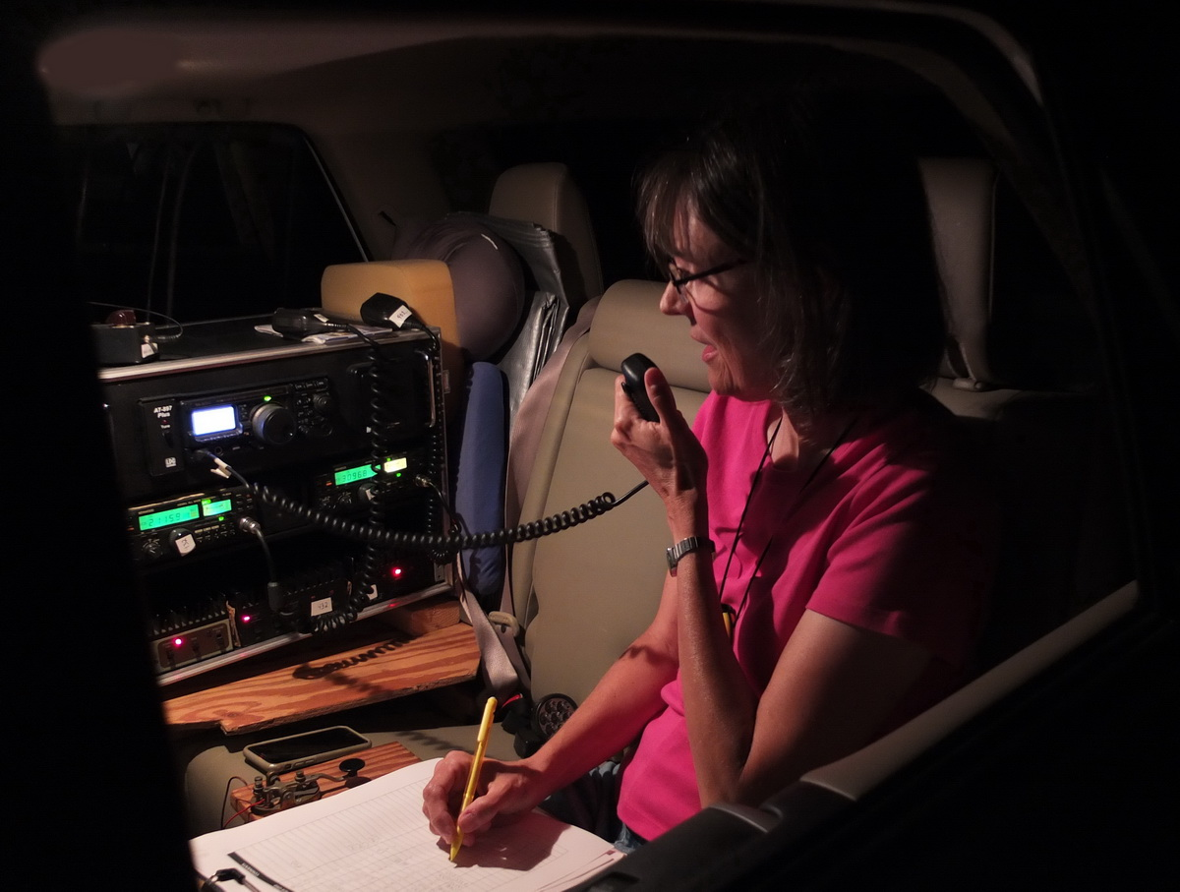

Slide 6
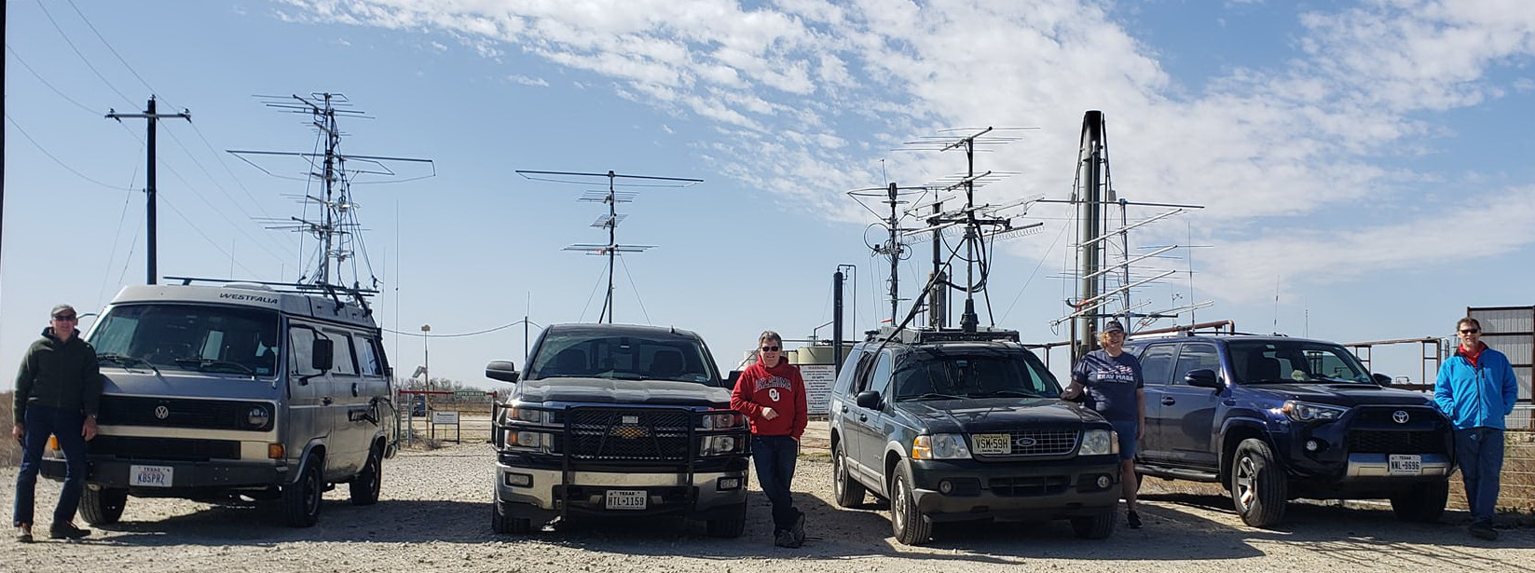

Slide 7
We have bands at:
50-54 MHz 6 Meters
144-148 MHz 2 Meters
222-225 MHz
420-450 MHz 70 cm
902-928 MHz
1240-1300 MHz
2300-2310 MHz
And higher

Slide 8
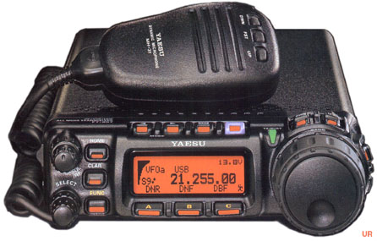
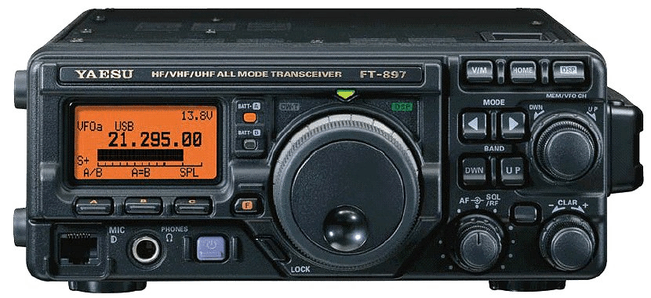
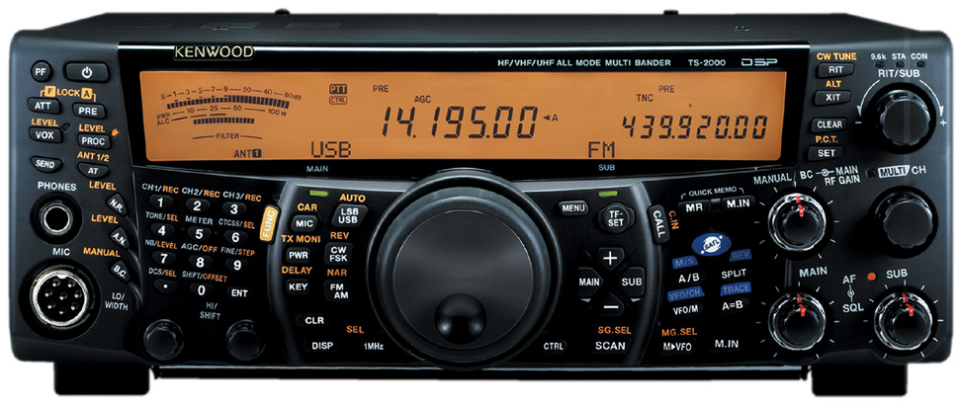
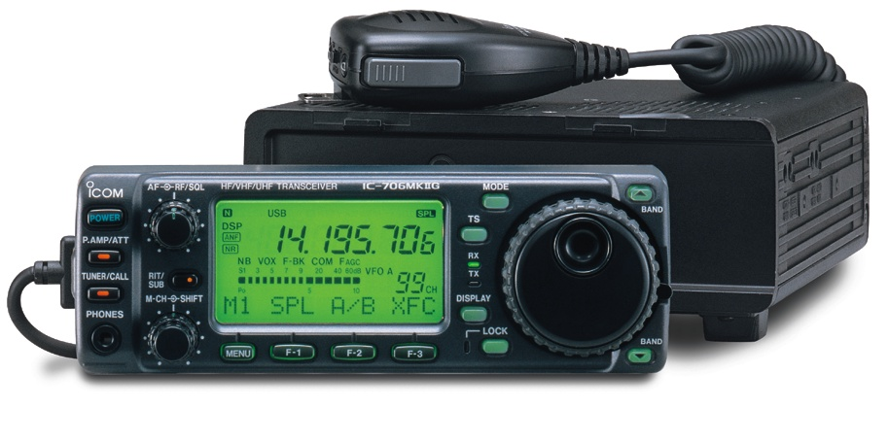
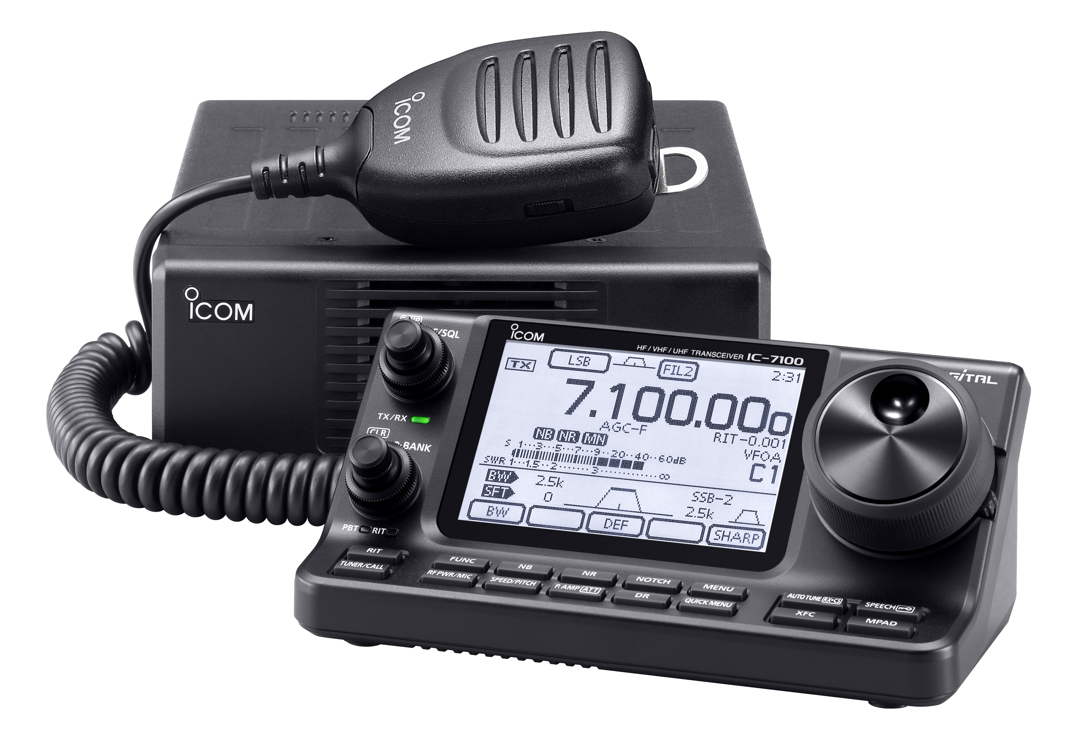
Versatile Rigs – Do you own one?
Include 6 meters, 2 meters, and 70 cm !!

Slide 9
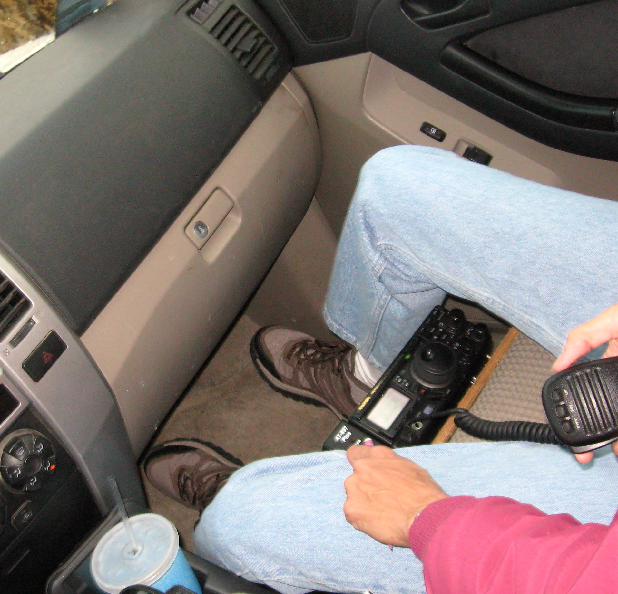
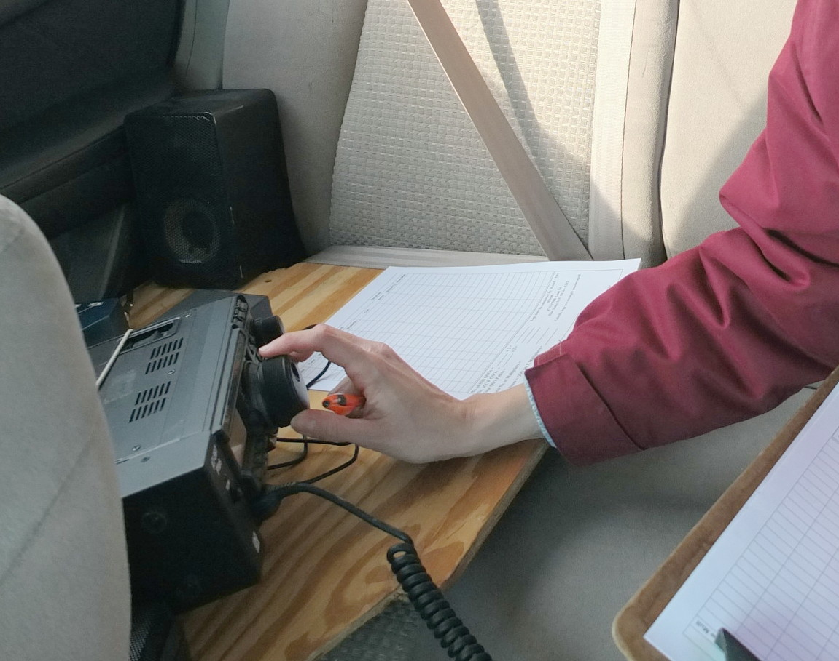
Put the rig in the car
Back Seat
Front seat

Slide 10
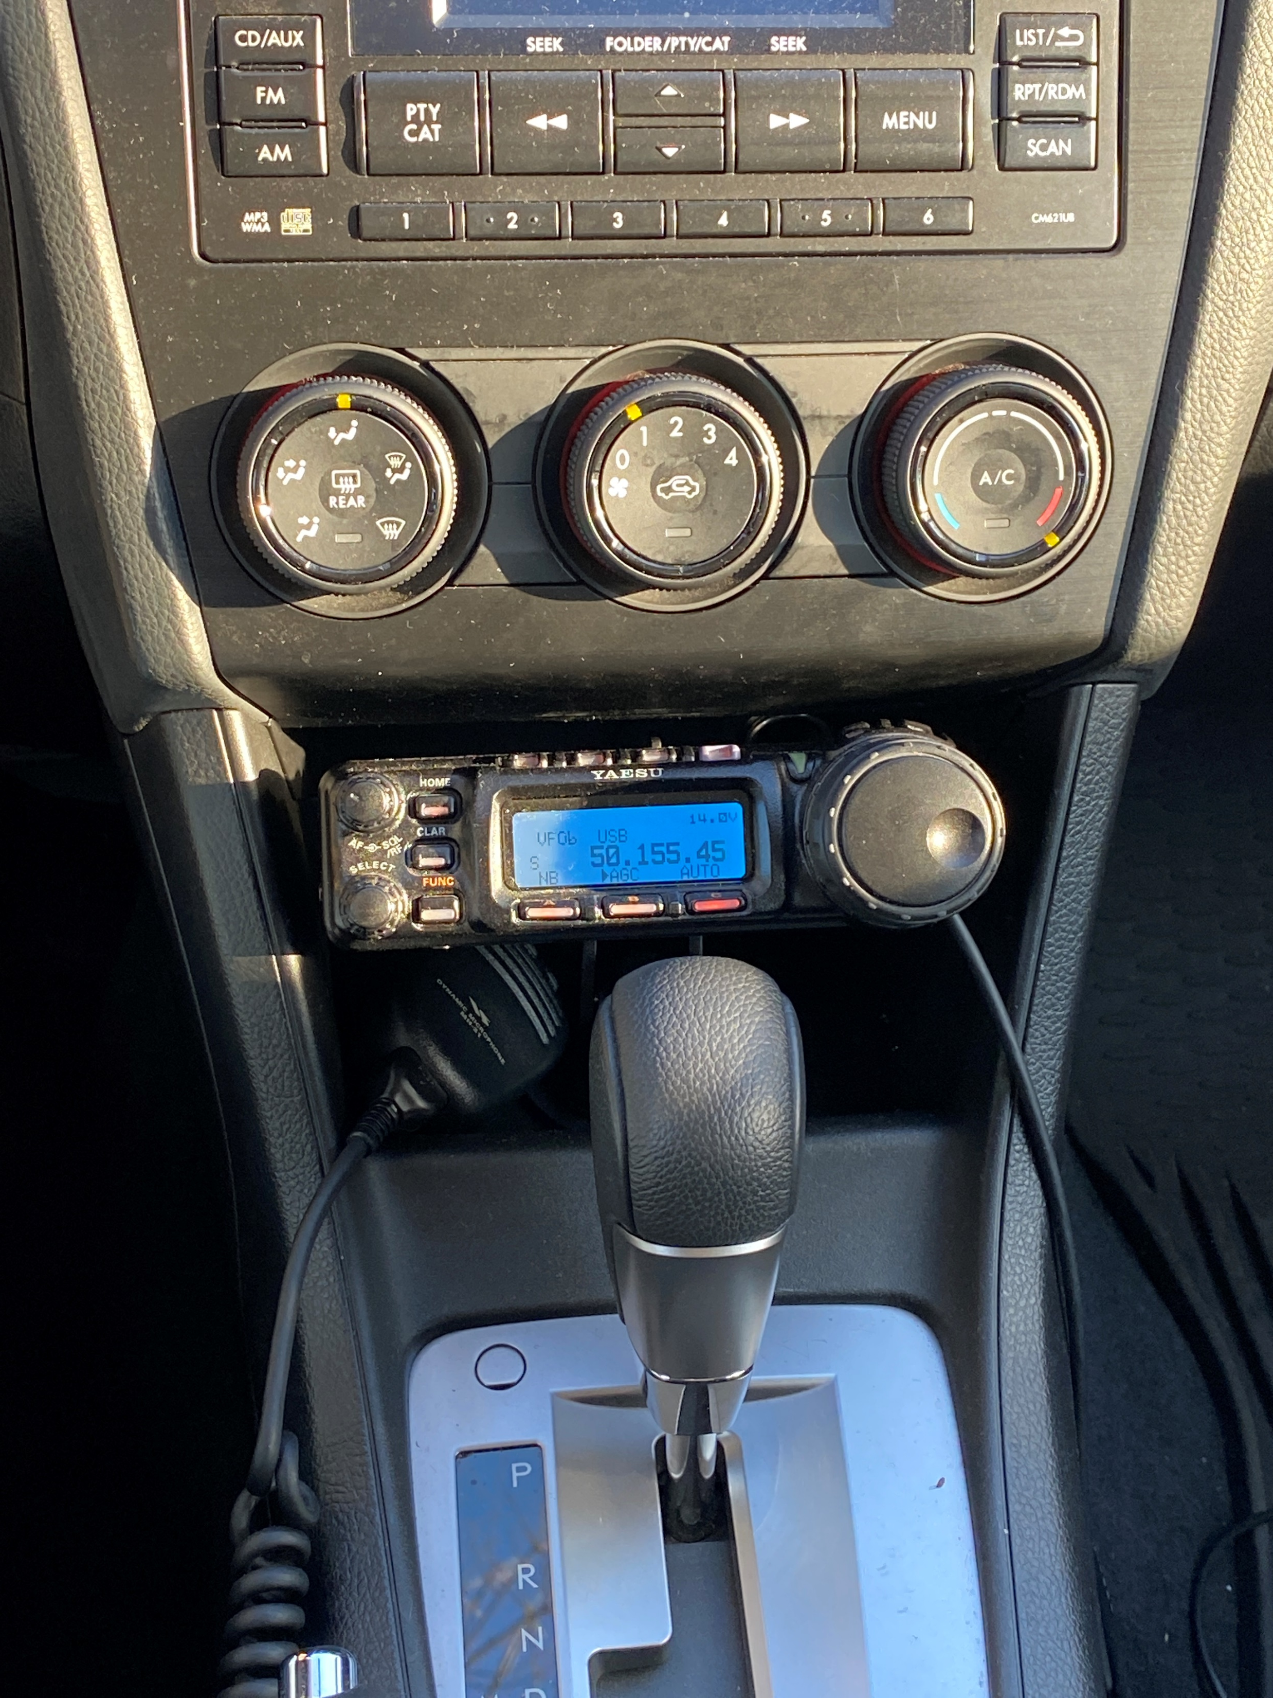
Put the rig in the car
Neat install!

Slide 11
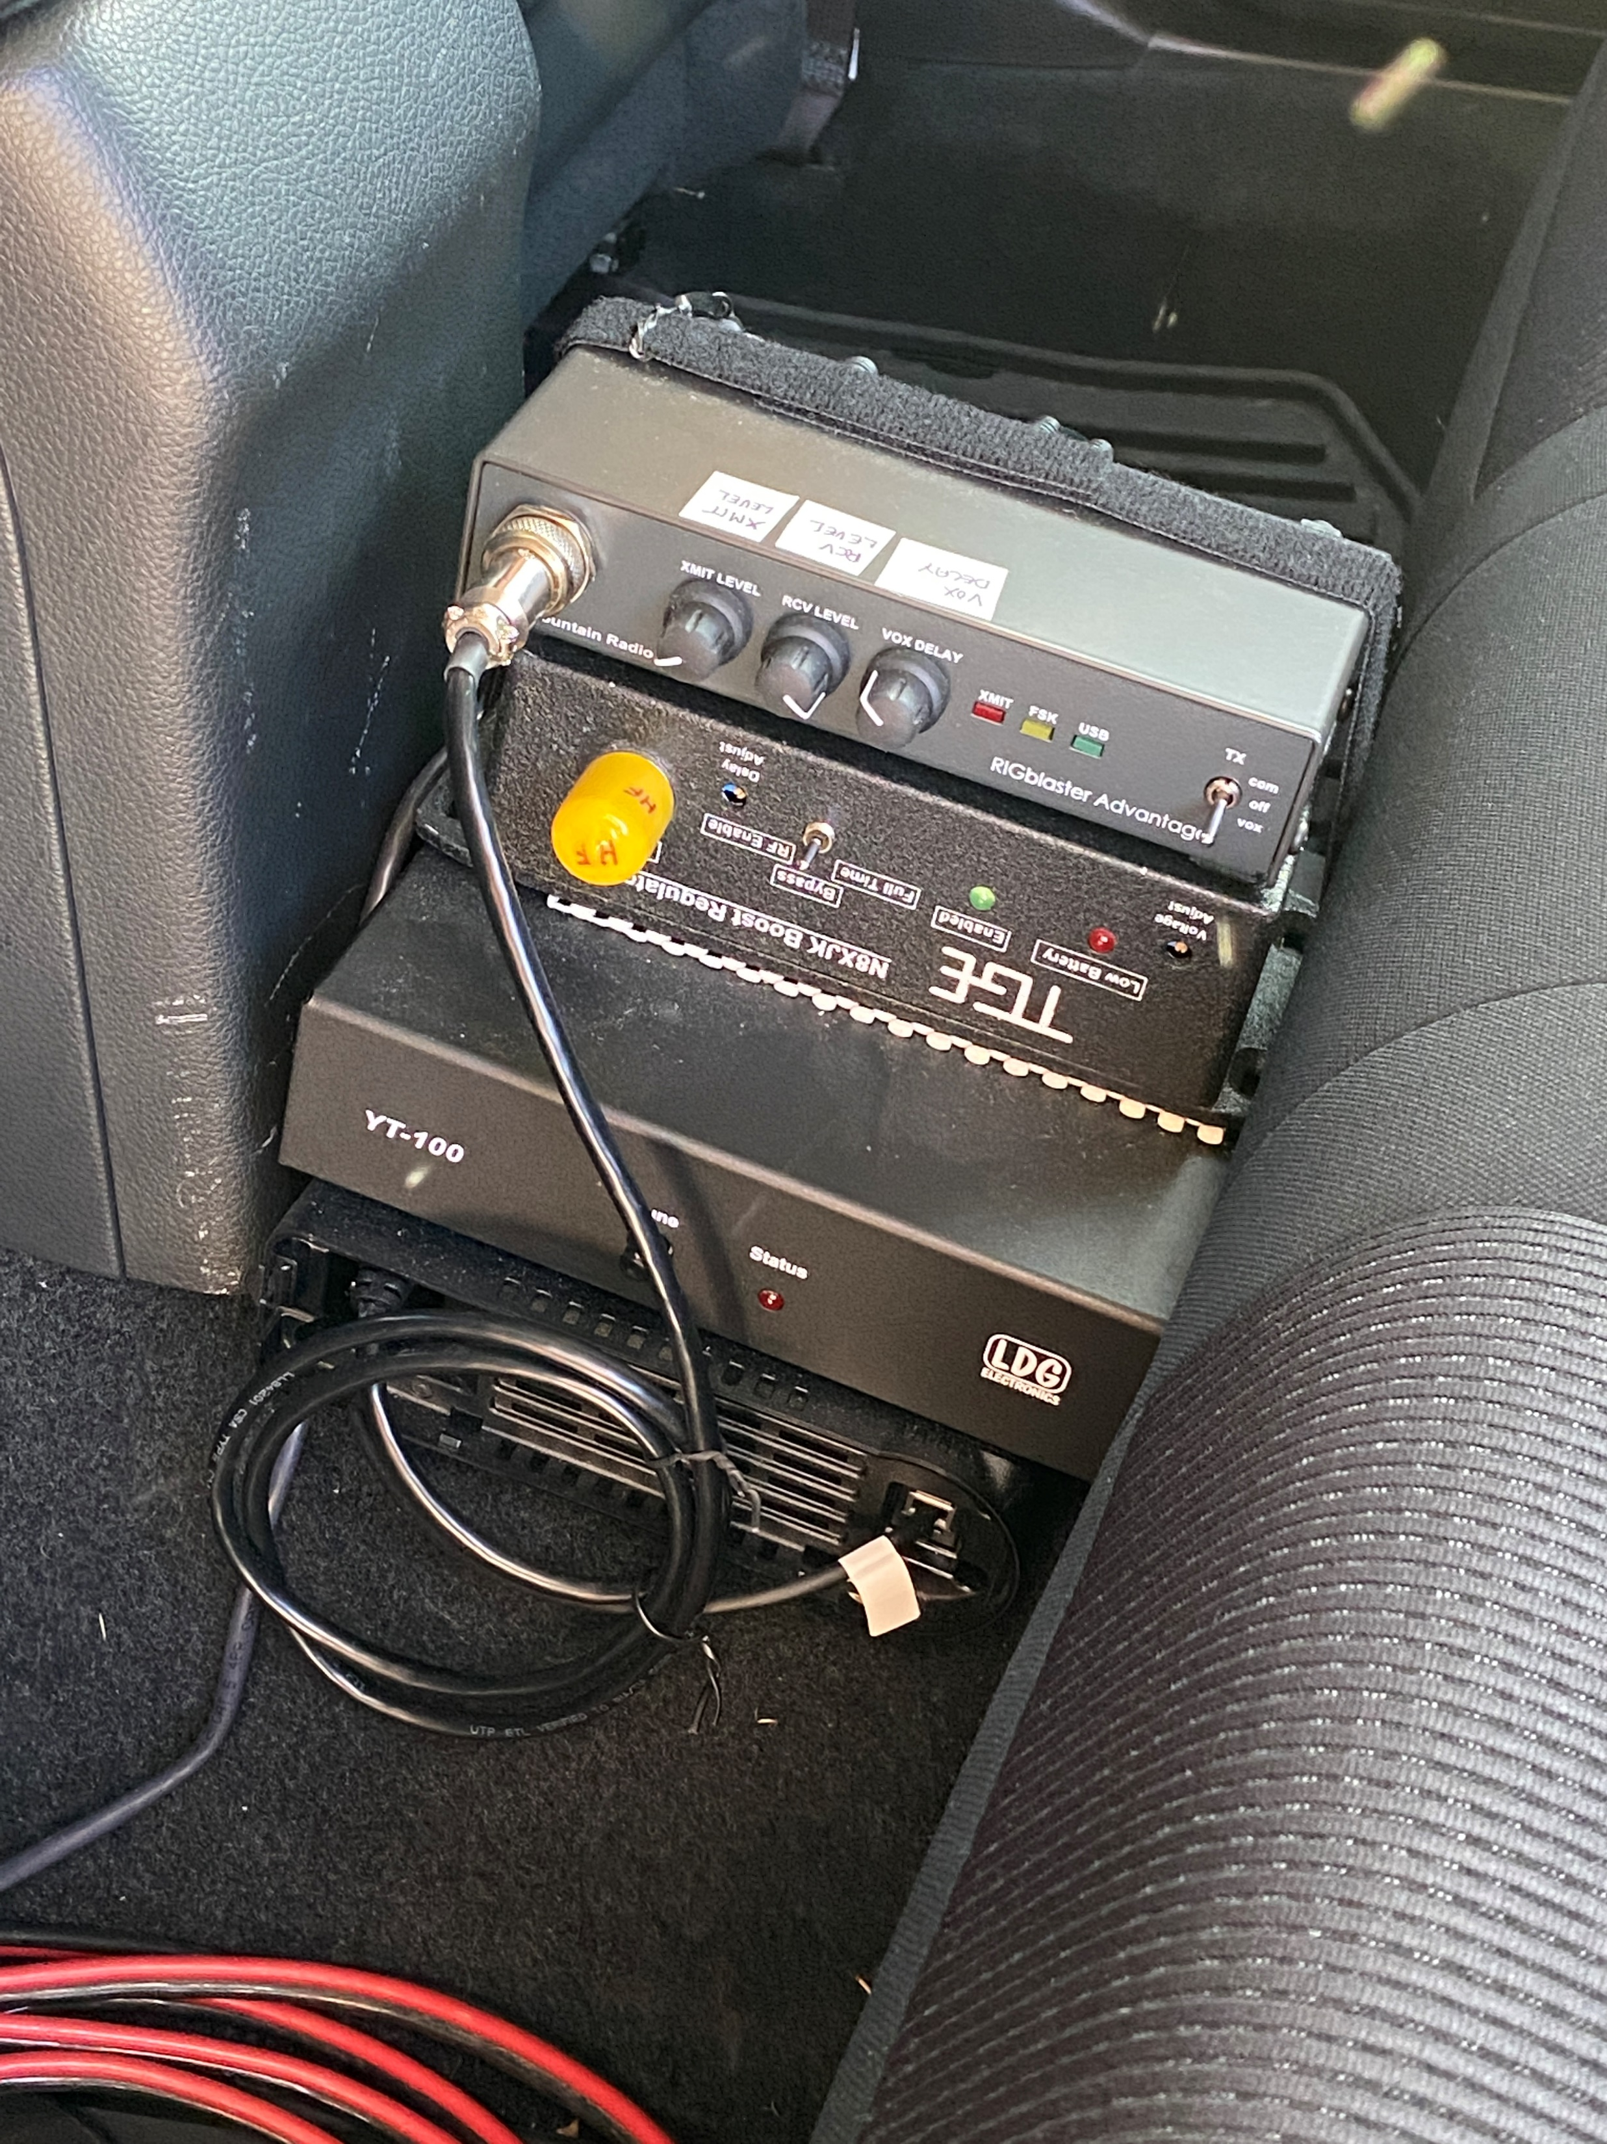
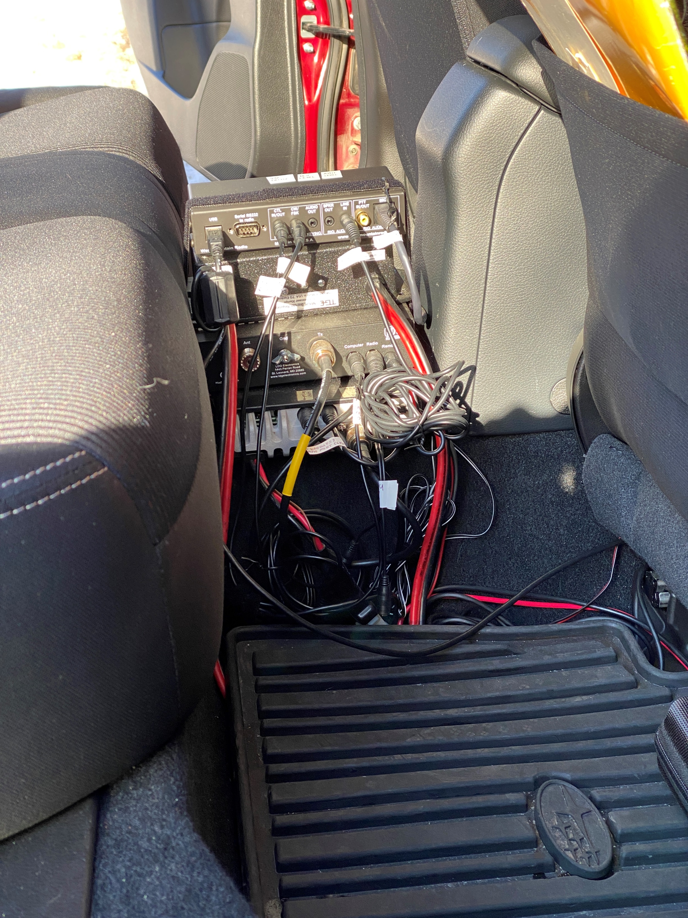
Put the rig in the car

Slide 12
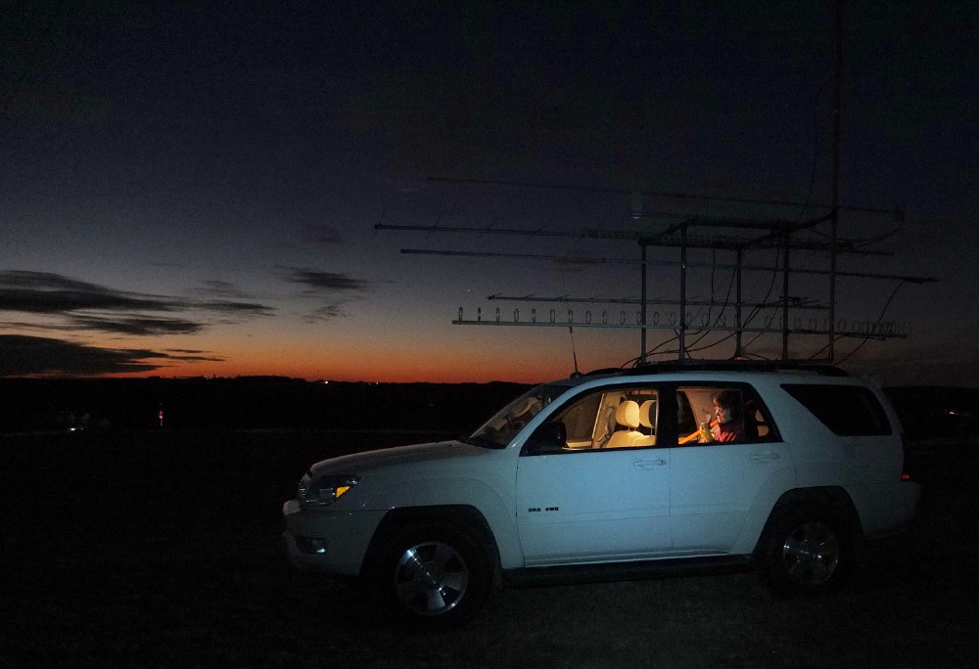
Operating: Rover
Hooking Up to DC Power
  DO NOT use the cigarette lighter!
  Run equipment to the car’s battery
  Consider adding a battery booster to maintain consistent 13.8 V output
  Car battery power will be just fine for the 50 to 100 watts the rig will put out

Slide 13
Hook up to DC
No, don’t use the lighter
Run it to the battery
That will be just fine for the 50 and 100 watts the rig will put out
And 100 watts on 6m, 50w on 2 meters, and 50w on 432 MHz is just fine
Some integrate 2nd batteries into their systems

Slide 14
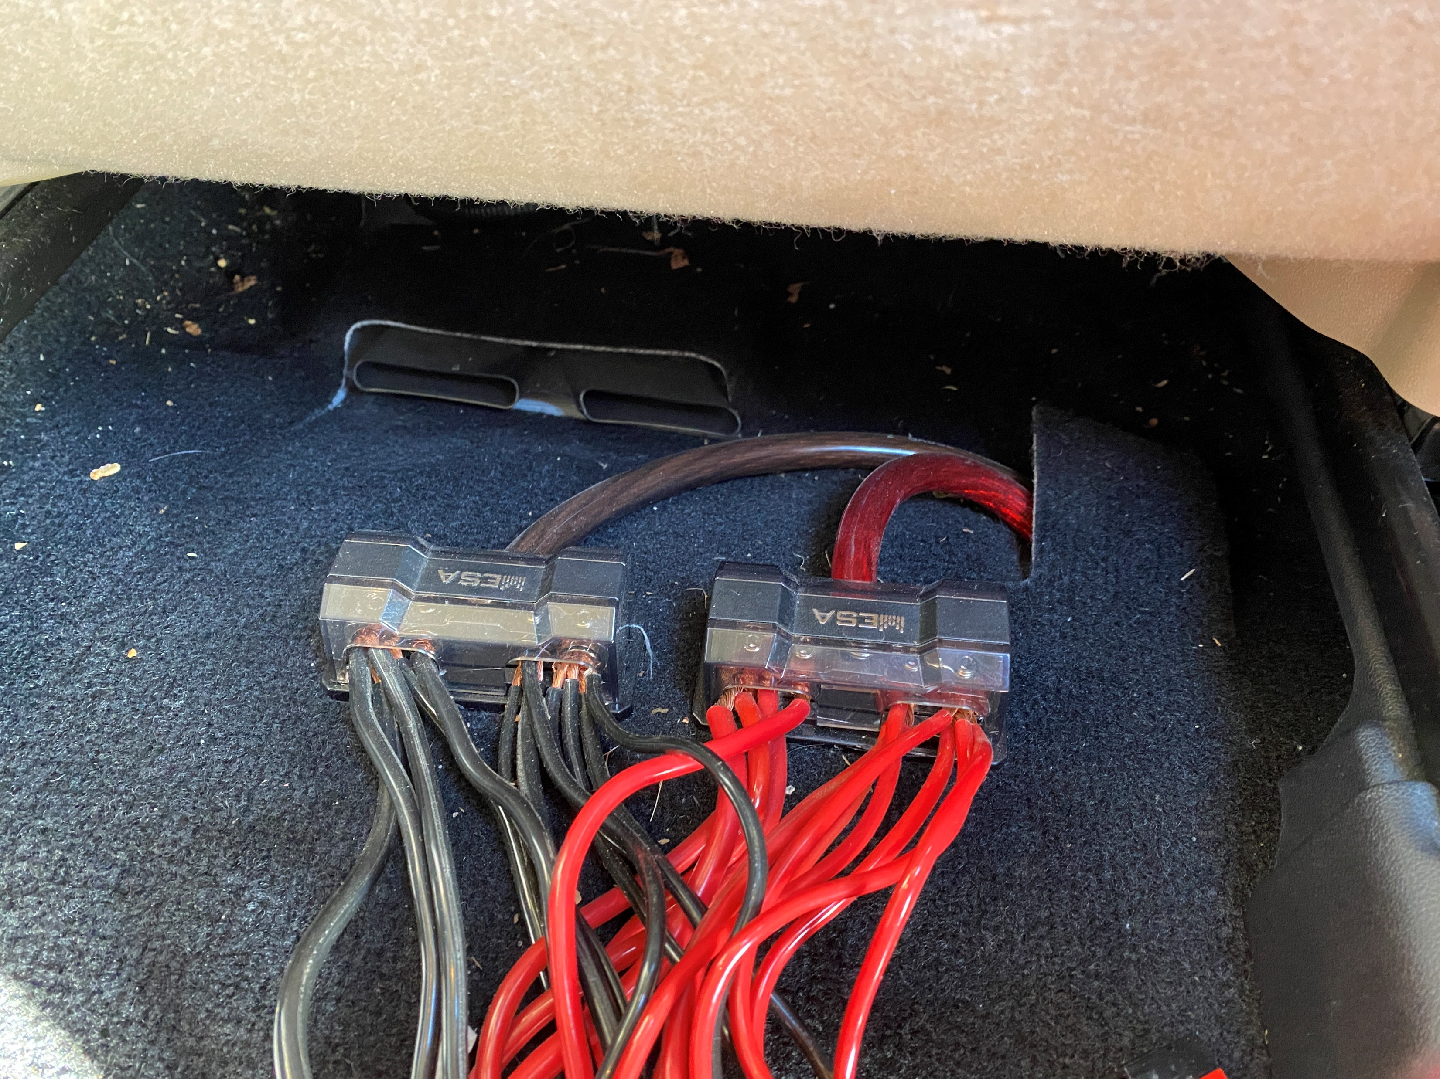
Hook up to DC

Slide 15
Coax
Low loss is best. Attenuation is db/ft
Hate to lose signal in lossy coax—both transmit and receive
Ultraflex is nice for rover installations

Slide 16
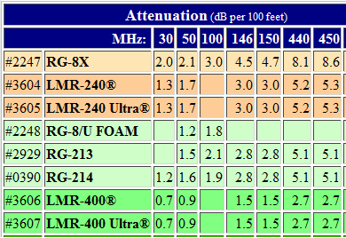
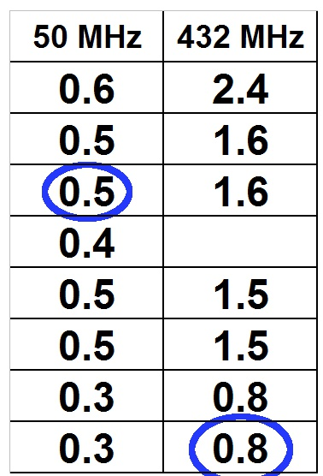
30 foot chunk
My favorites are LMR-240UF for 6 Meters
and LMR-400UF for 2 Meters and 70cm

Slide 17
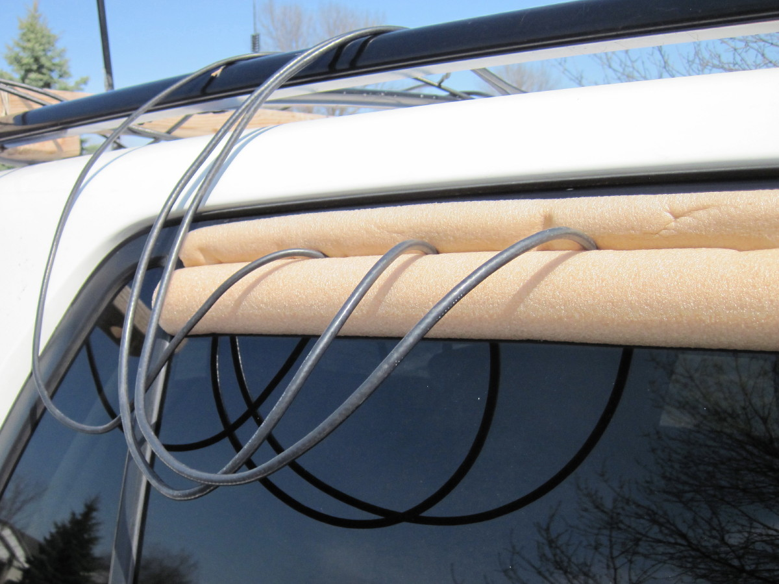

Slide 18
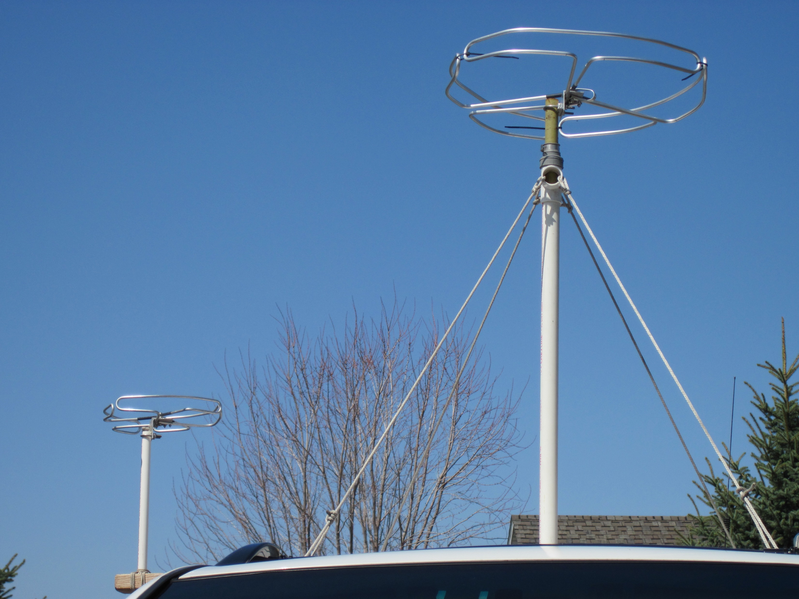
Antennas
Omnis?
Range about 60 miles
Simple

Slide 19
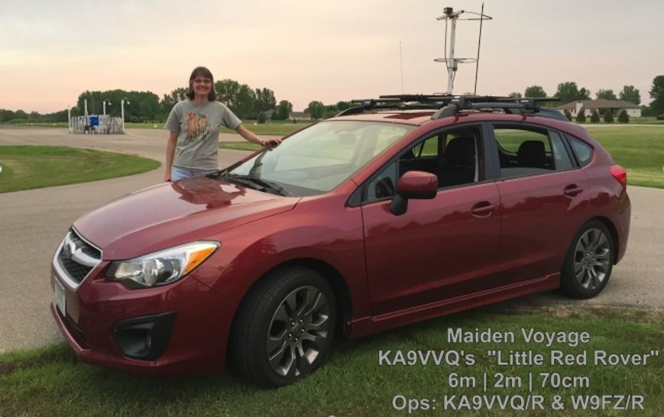
Operating: Rover
Simple Mag Mounts…

Slide 20
Operating: Rover
“Tiny Tower”, Complete With Antenna Rotator…

Slide 21
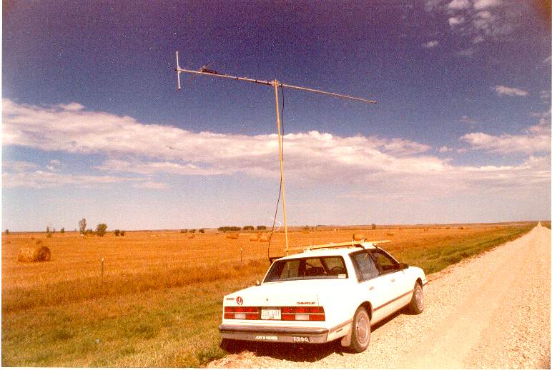
Beams – reach out and touch

Slide 22
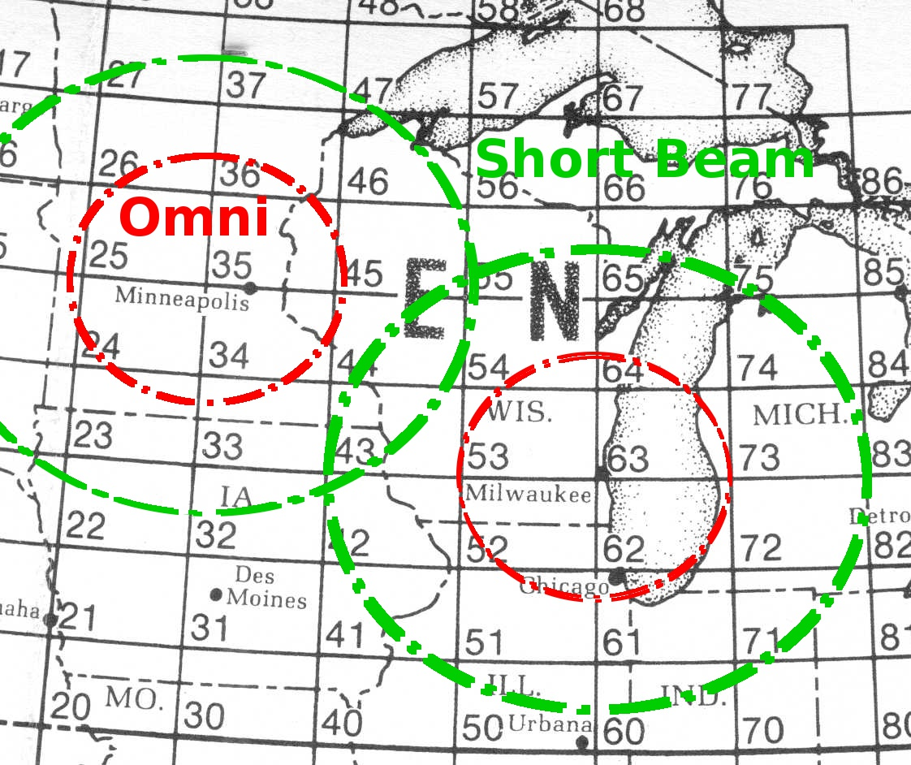

Slide 23
Commercial Beams
Cushcraft
M-Squared
Directive Systems
Beams: Increasing complexity to increase range and coverage

Slide 24
WA5VJB “Cheap” Yagis
Kent designed an easily replicated antenna tolerant of abuse
http://www.wa5vjb.com/yagi-pdf/cheapyagi.pdf
Driven element is a “J”. Proximity of first director and reflector “load” the J such that feedpoint impedance is near 50 Ohms.
Build your own for minimal $

Slide 25
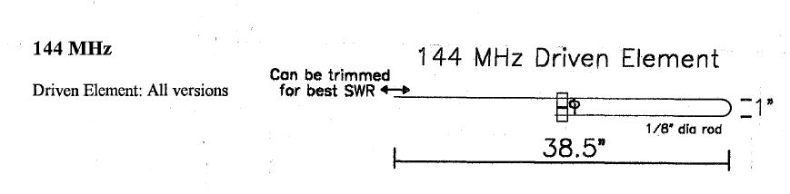
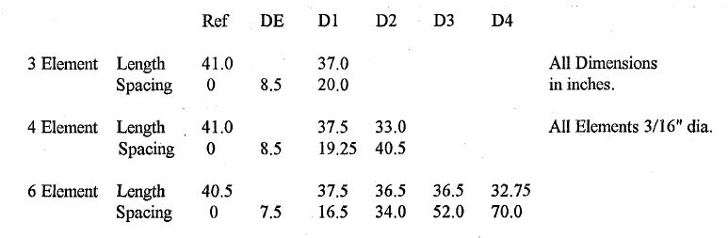

Slide 26
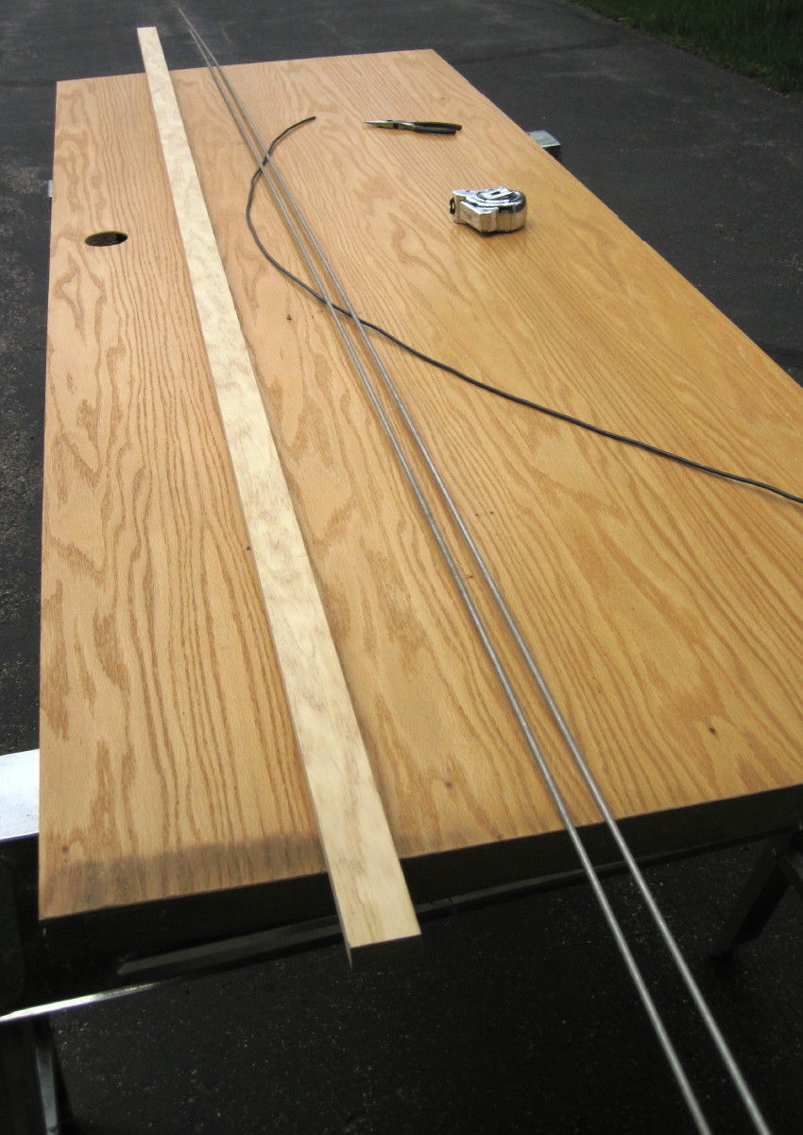

Slide 27
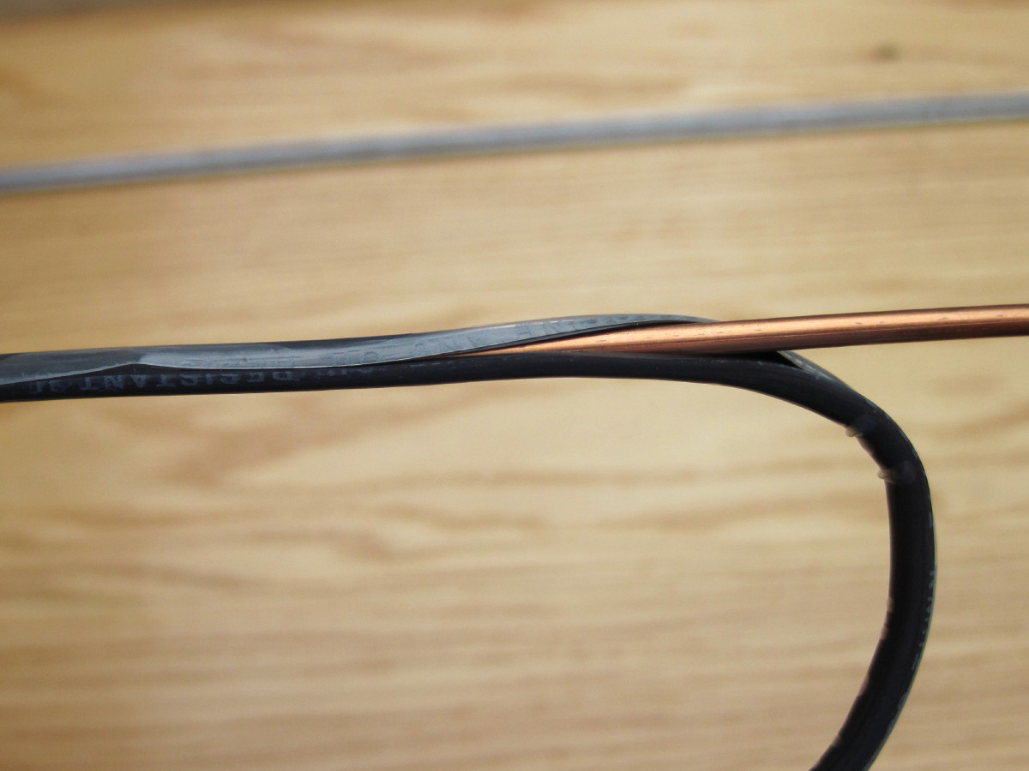

Slide 28
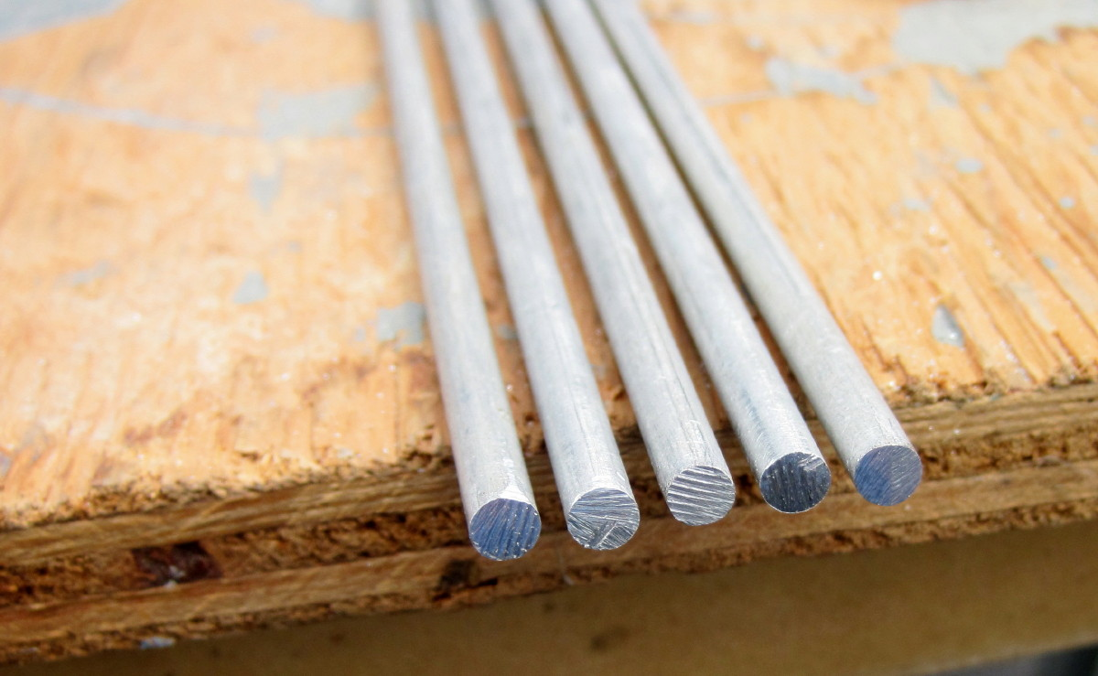

Slide 29
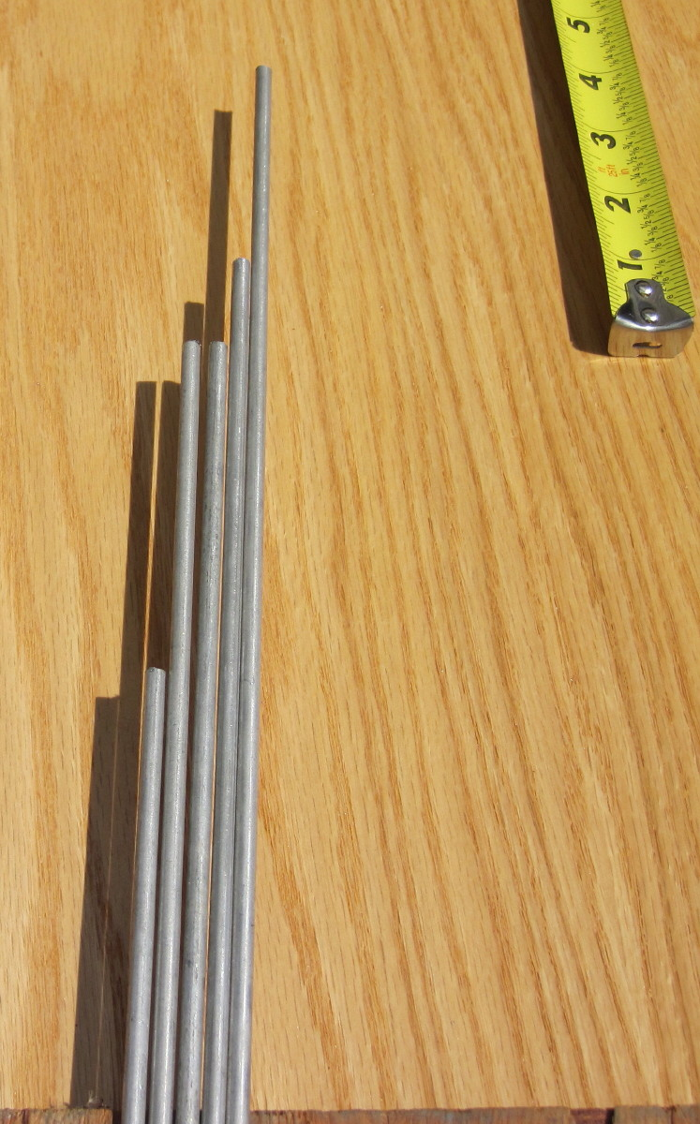

Slide 30
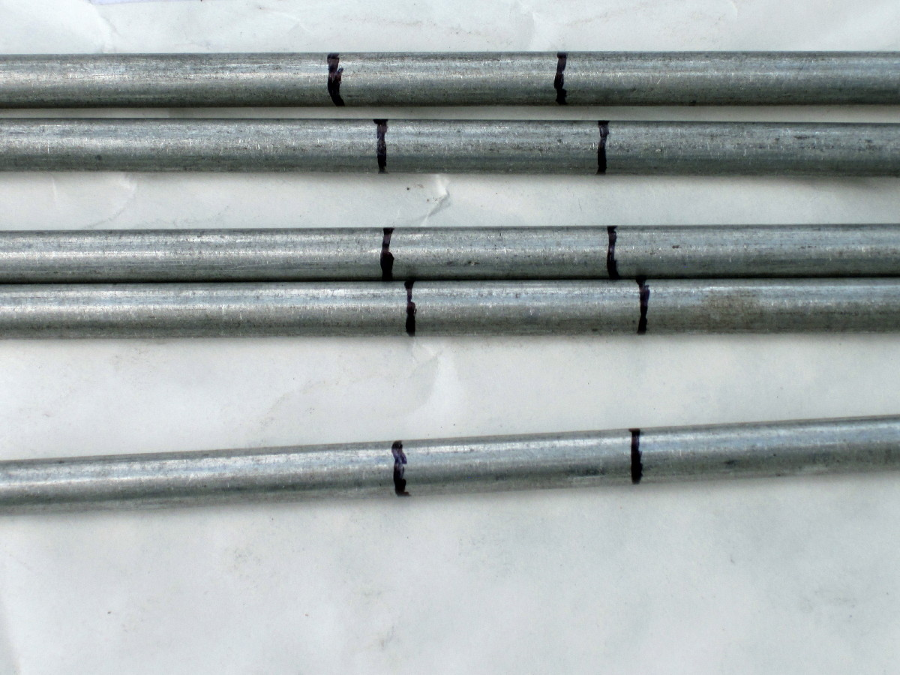

Slide 31
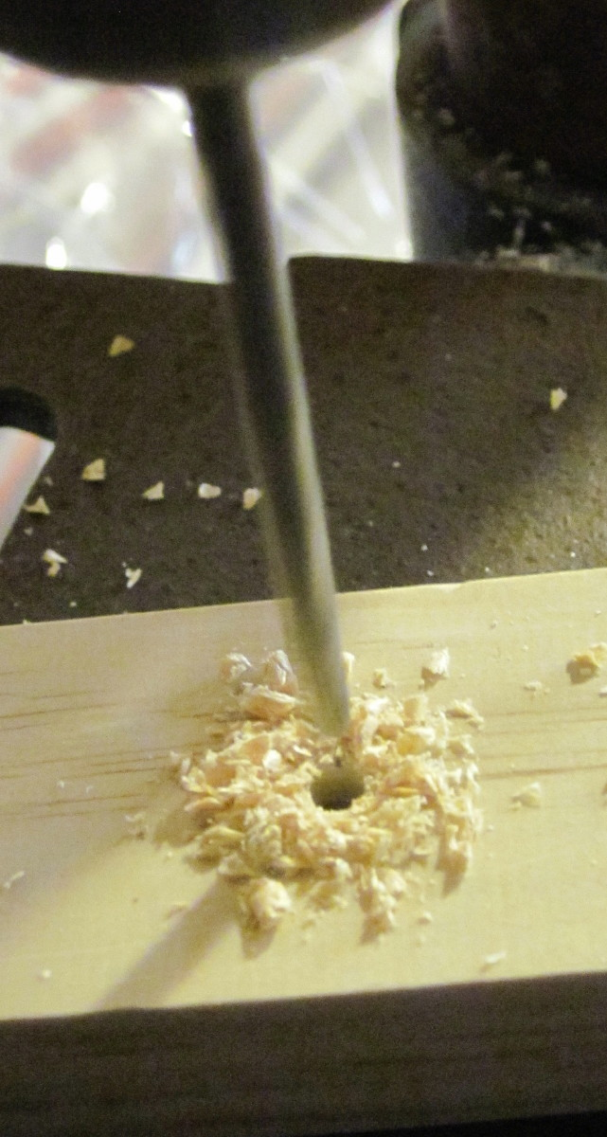

Slide 32
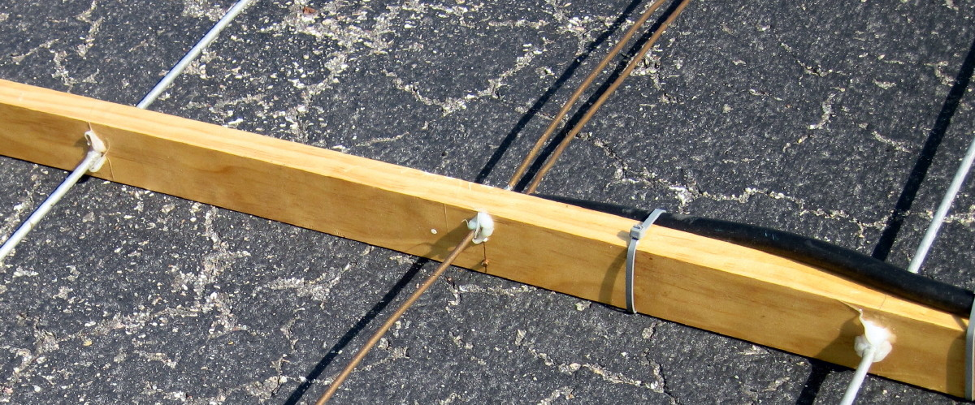

Slide 33
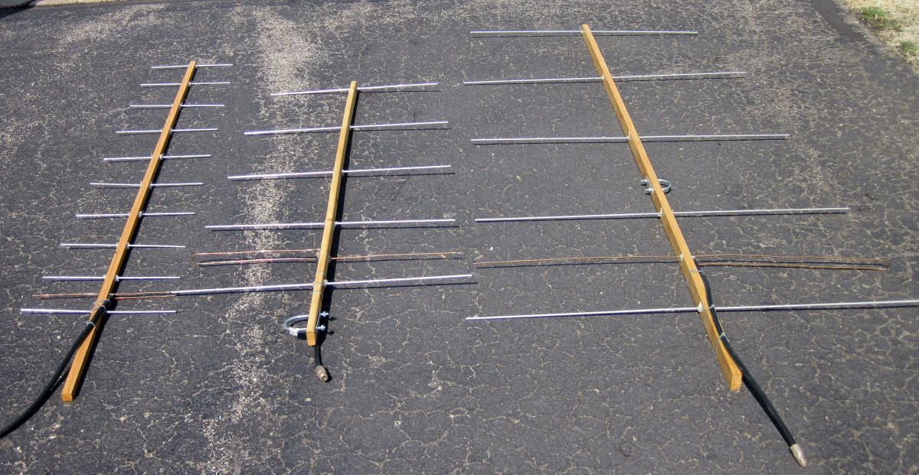
432 MHz 222 MHz 144 MHz

Slide 34
For 6 Meters
Dipole, Halo, or Moxon
I prefer a dipole
Height is VERY helpful
Hamstick if only working E-Skip ………..or if in a jam

Slide 35
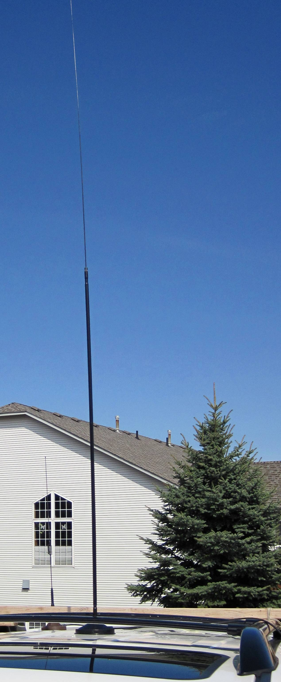
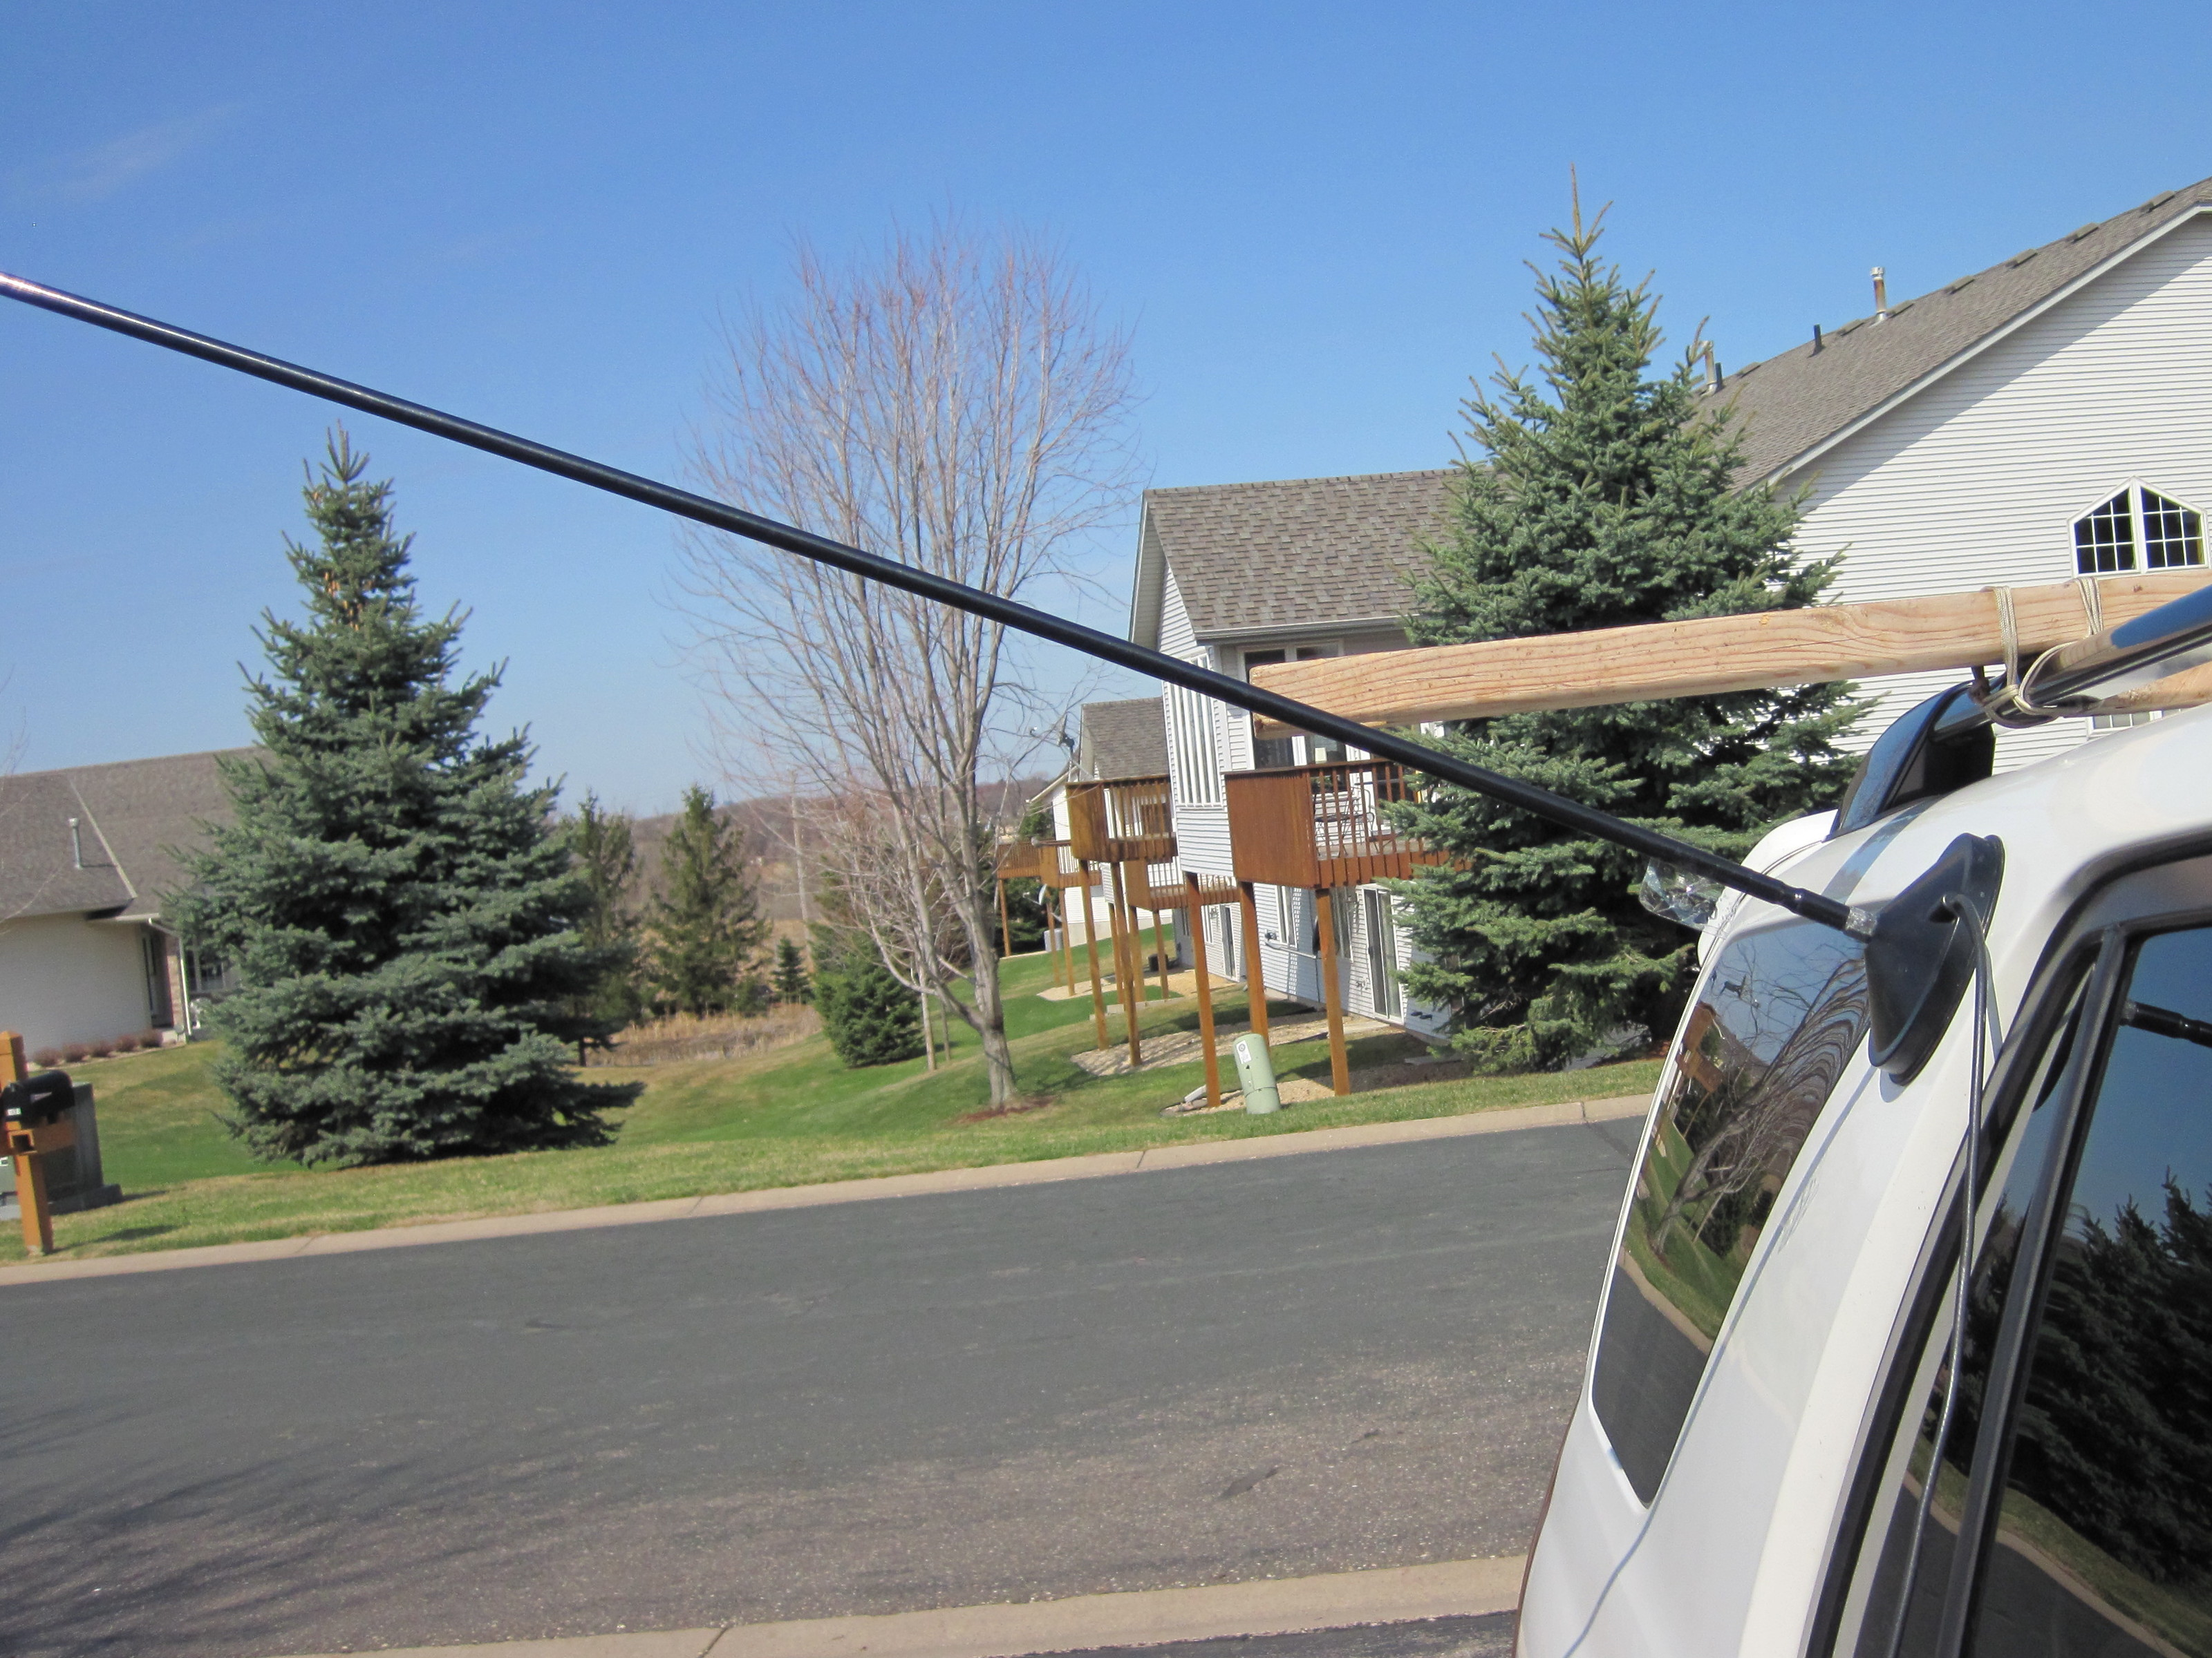

Slide 36
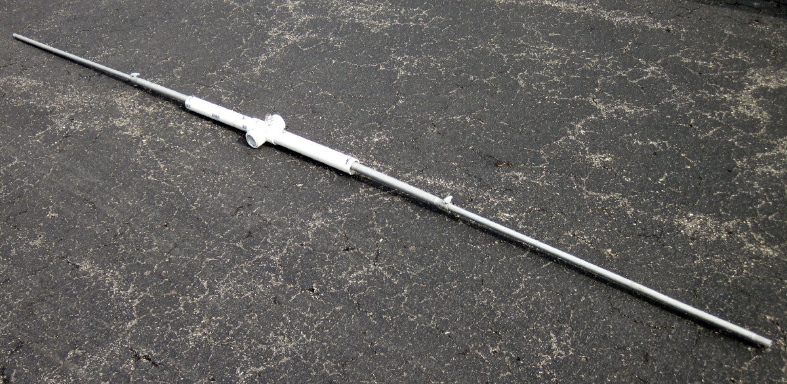

Slide 37
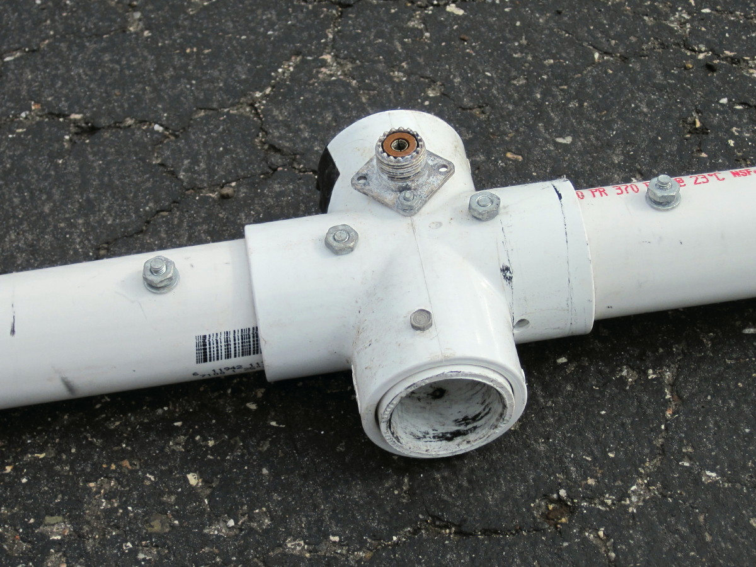

Slide 38
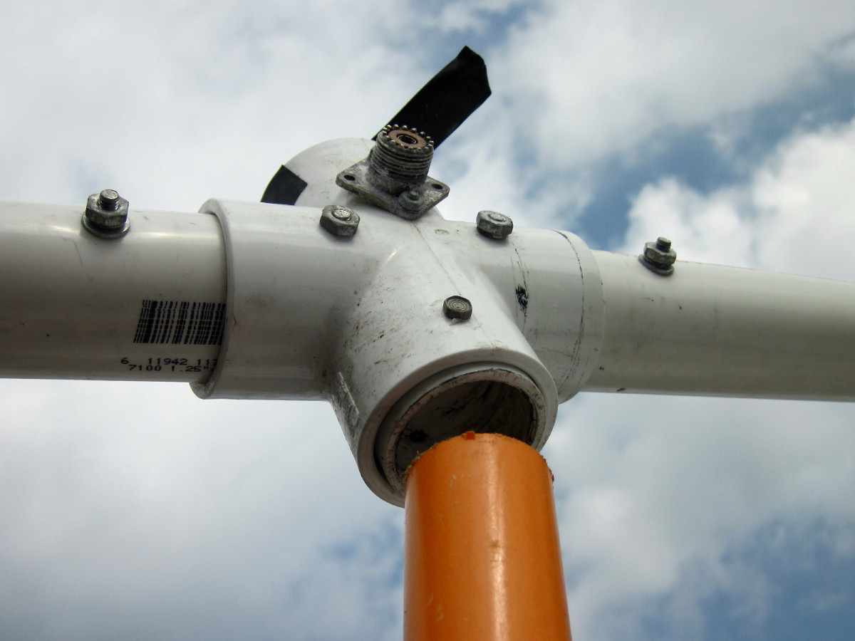

Slide 39
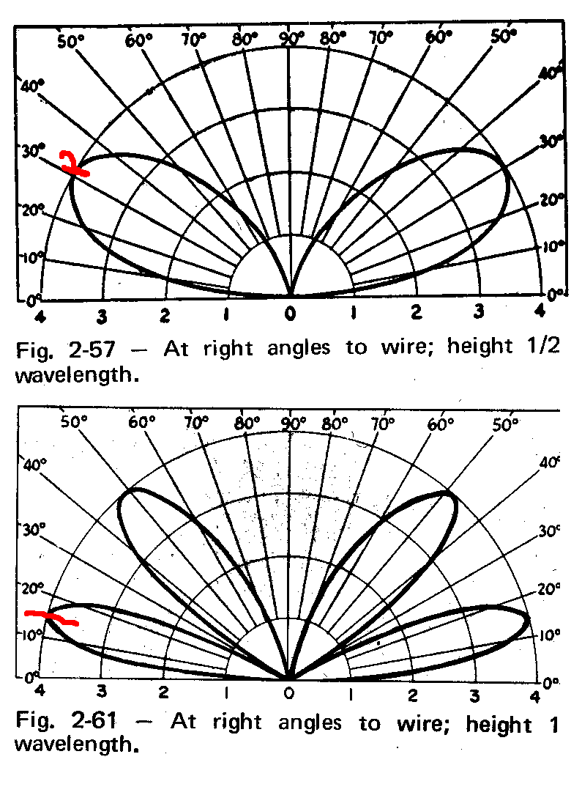
I work K2DRH, W9GA, W0UC, N9DG, and sometimes W0ZQ from hundreds of miles away using a dipole (on 6m) at 18
Feet (and CW).

Slide 40
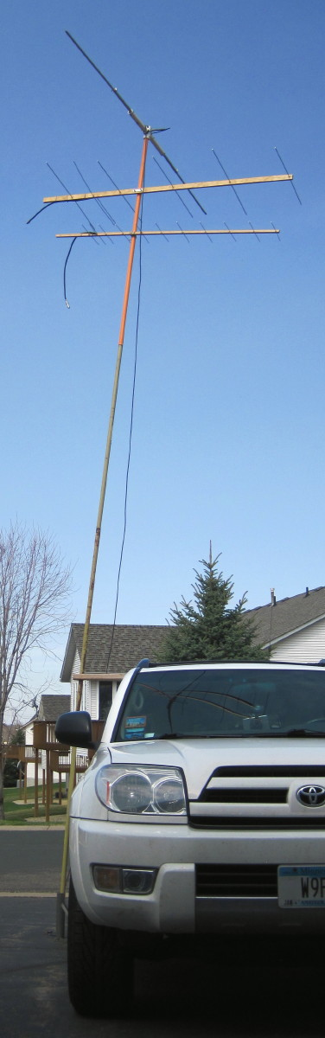
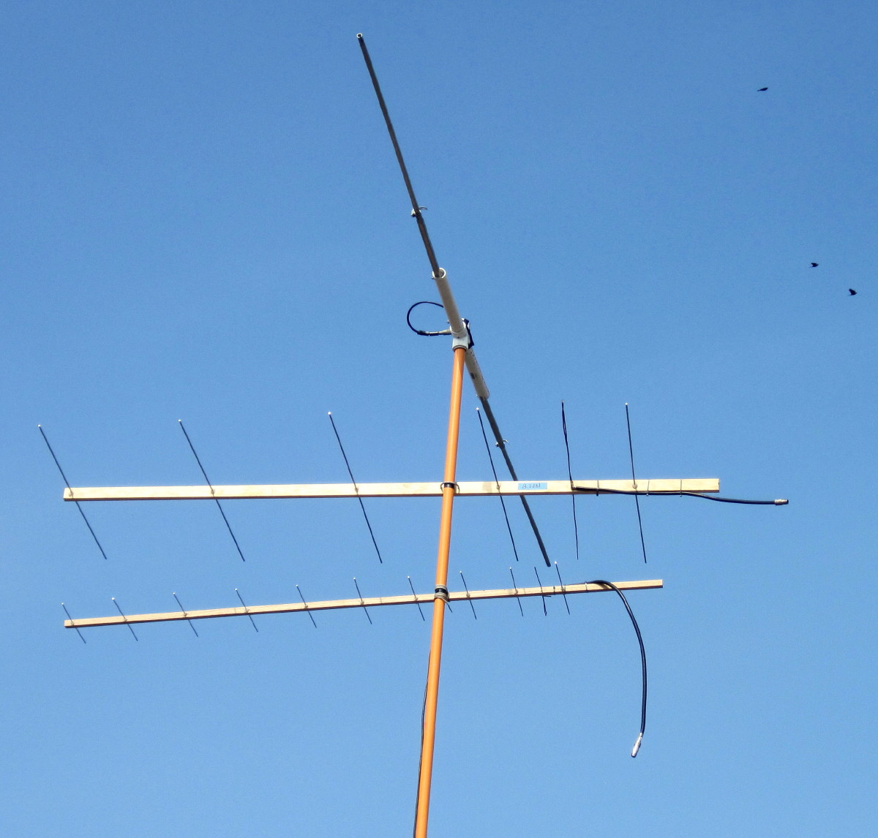

Slide 41
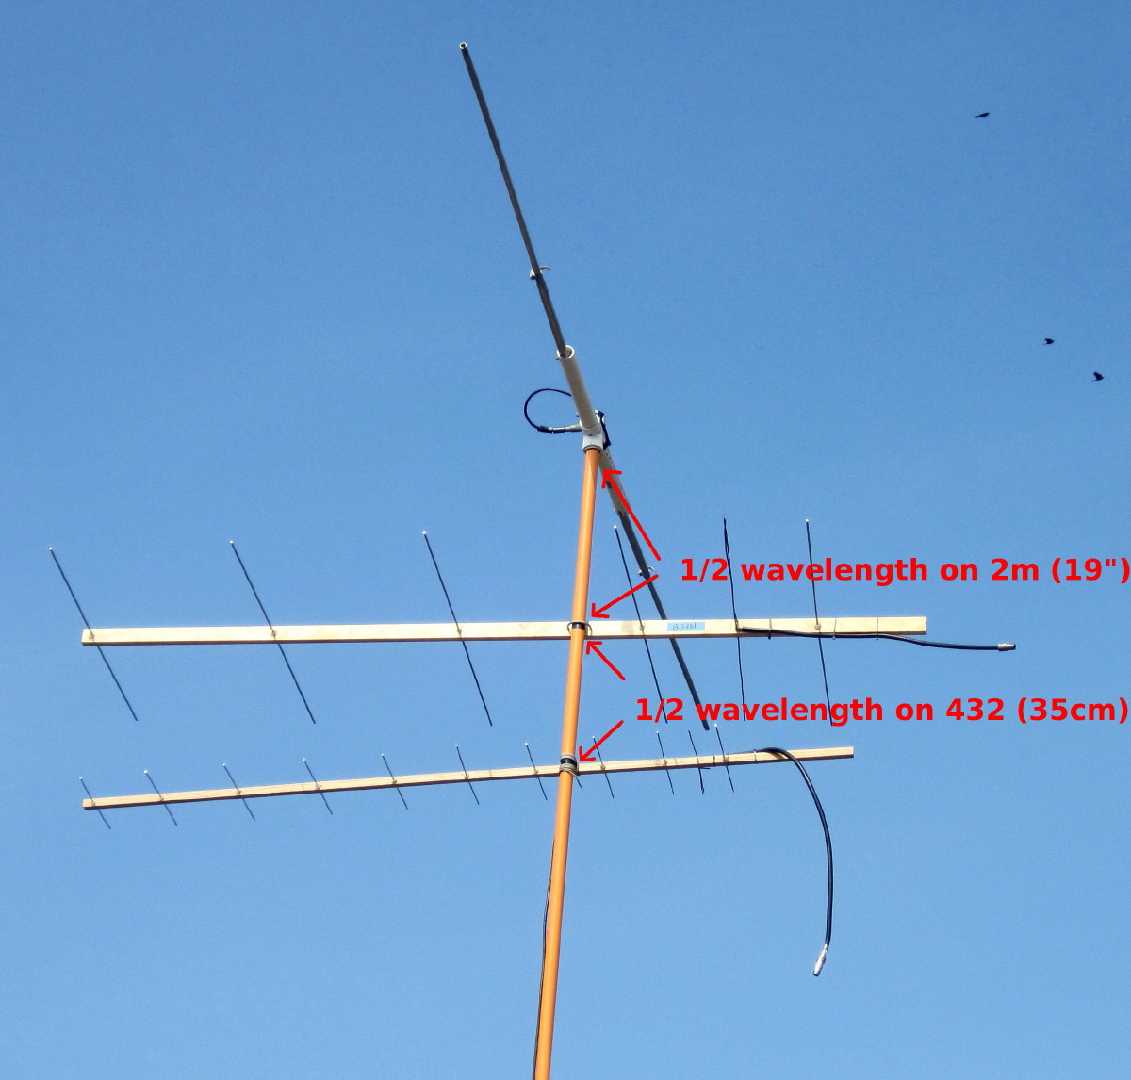
Short “sees” long
but long doesn’t “see” short

Slide 42
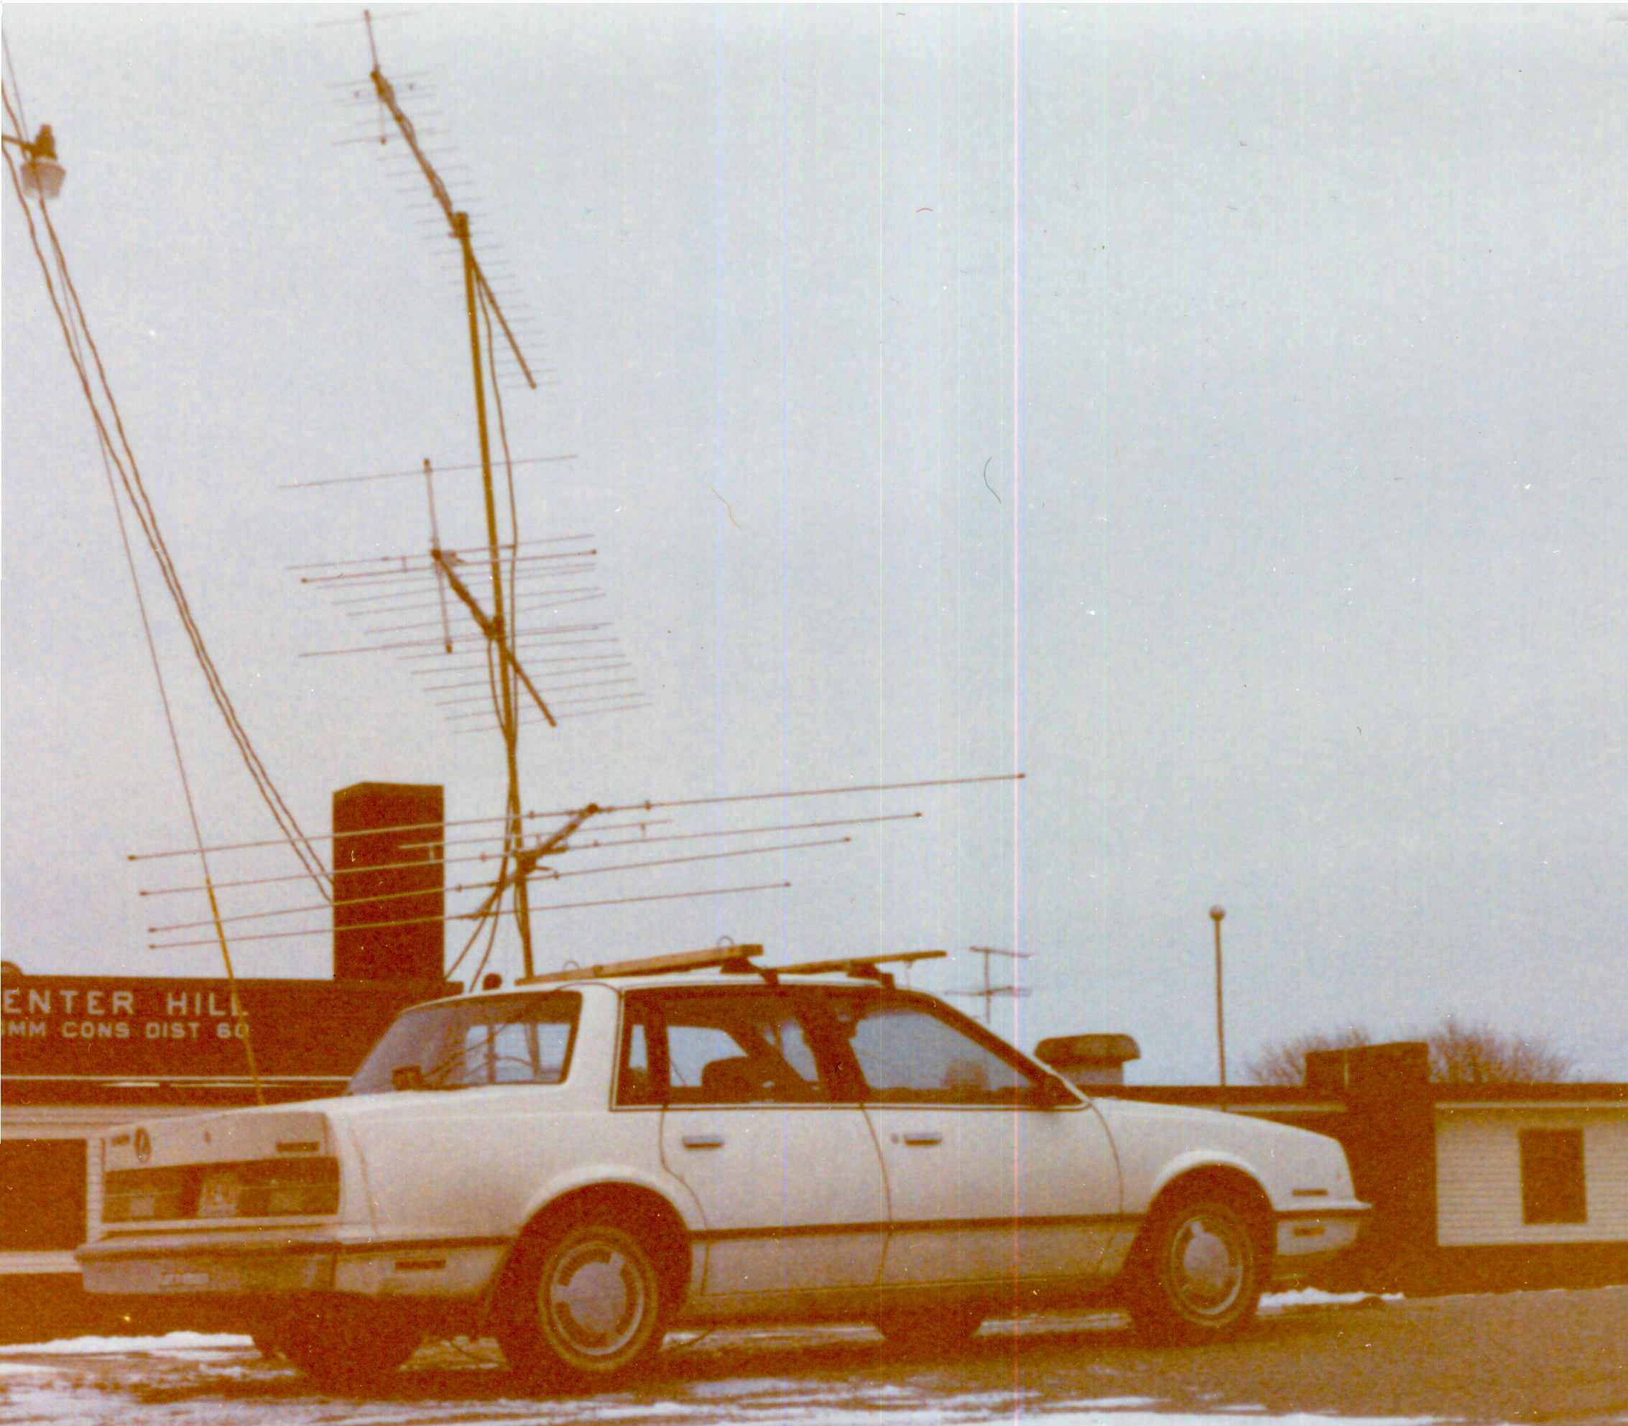

Slide 43
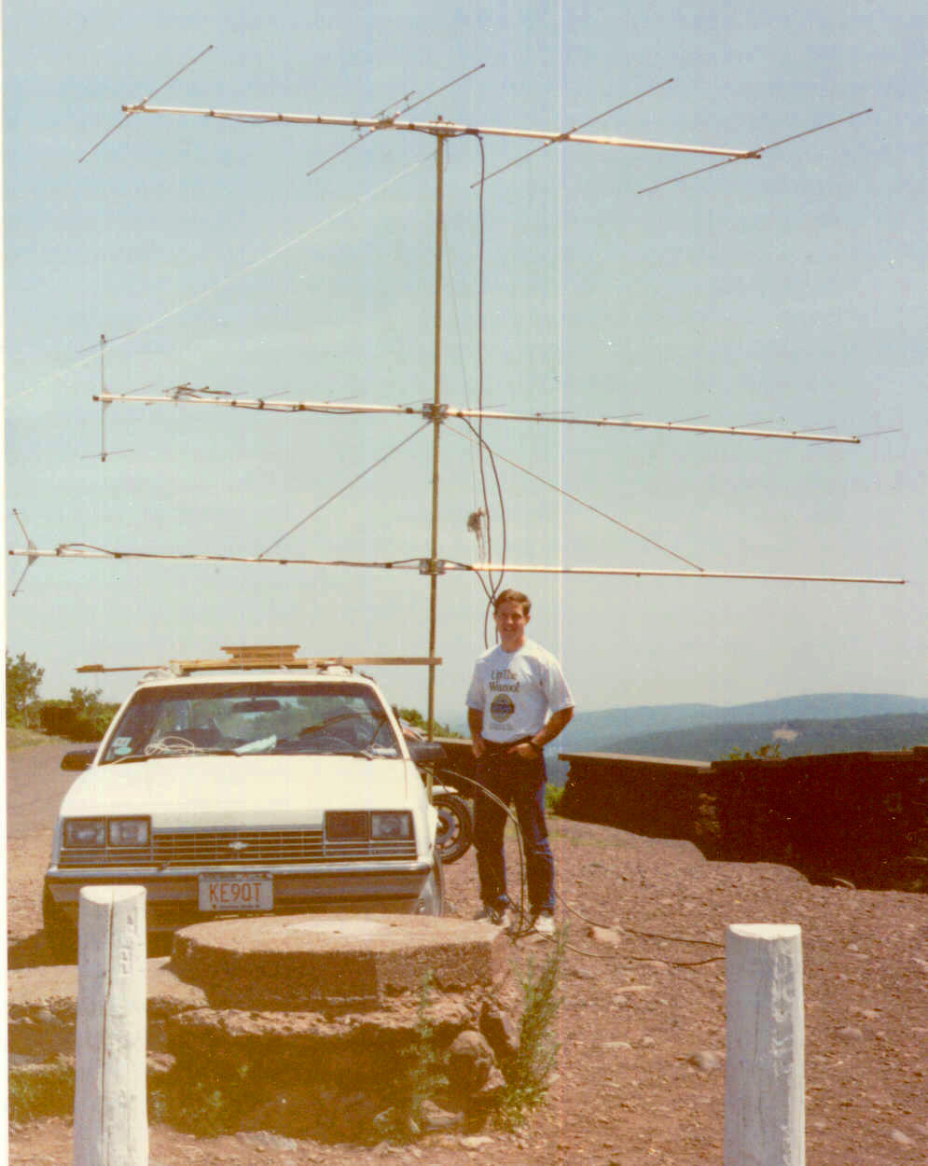

Slide 44
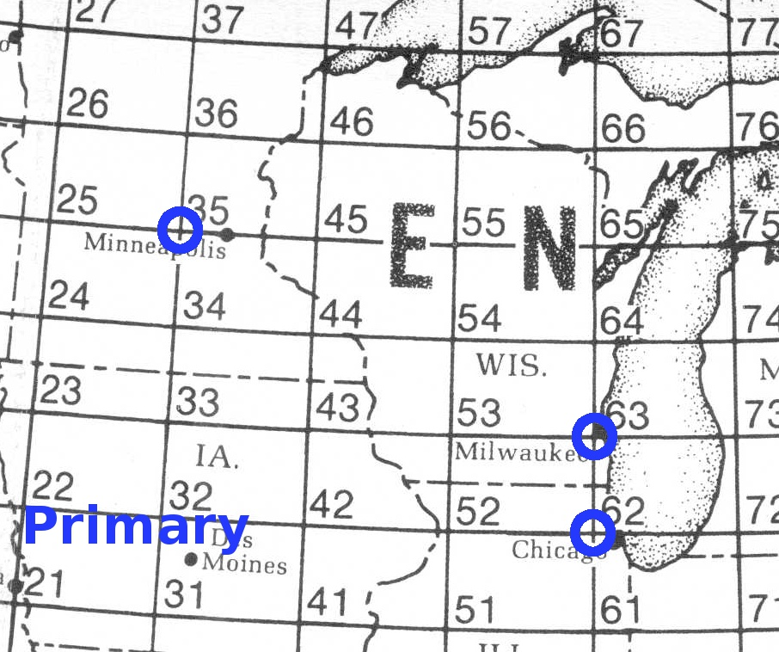
Grid Corners are Nearby

Slide 45
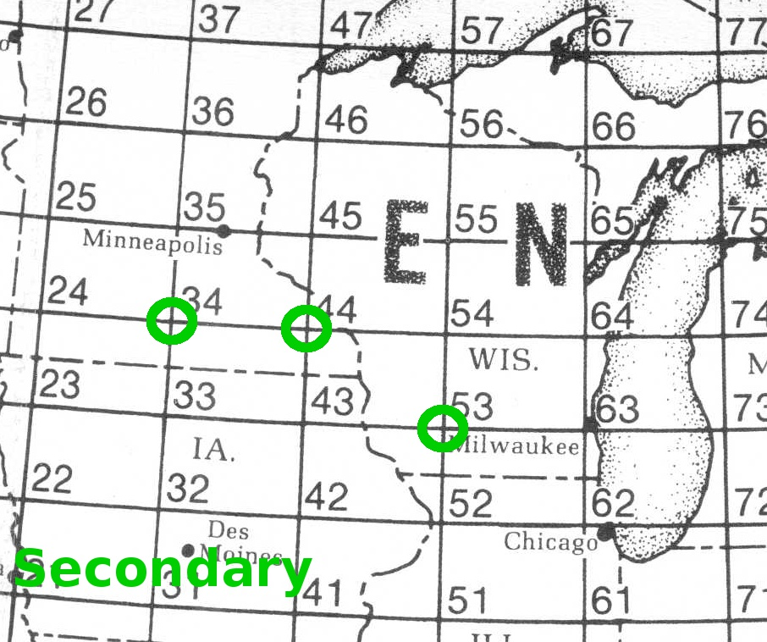
Grid Corners are Nearby

Slide 46
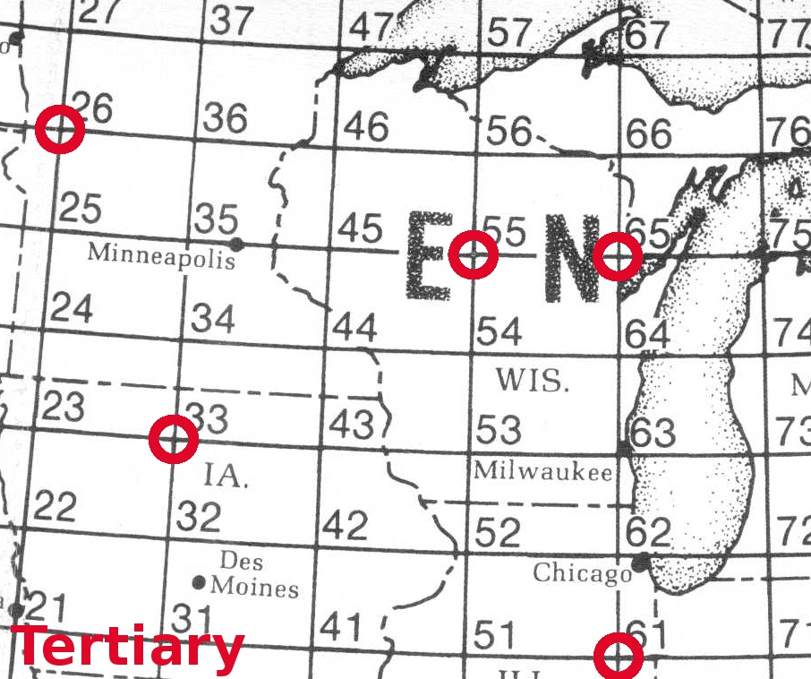
Grid Corners are Nearby

Slide 47
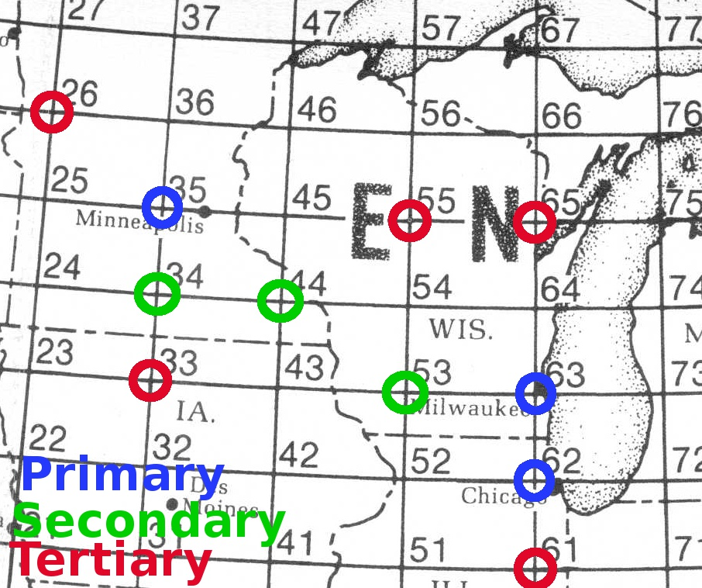
Grid Corners are Nearby

Slide 48
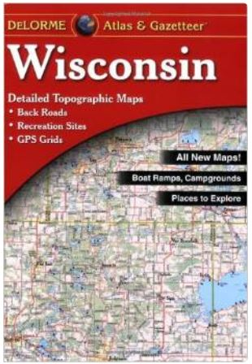

Operating: Rover Sites
Choosing an operating site
  Topographic road maps
    Delorme state atlases
    especially useful
      Elevation contours
      Back roads, dirt roads, trails
  HeyWhatsThat.com
    Web-based terrain profile
    analysis
  Understand grid squares
  and grid corners
  Radio Mobile terrain software

Slide 49
How to pick spots
DeLorme map books are essential
RadioMobile software helps
Google Earth helps a little
Pre-scouting visits prove usefulness of site
You need a place big enough and safe enough to park – or possibly spin – the car

Slide 50


Slide 51


Slide 52


Slide 53


Slide 54


Slide 55


Slide 56


Slide 57


Slide 58


Slide 59

Who are you going to work?
Fixed stations
And other
Rovers

Slide 60

Logging
Simplest is paper
logging
Computer logging scores
and post-processes easily

Slide 61


Slide 62

So What is Grid Circling?
Rovers working other rovers repetitively over trivial distances around a grid intersection.
It can lead to big scores and some
fun, but……….

Slide 63

What About FT-8 or FT-4?
Yes!
This is N9SD who roves with his son. They do mostly FT-8
near Milwaukee
It is complex to integrate into a rover but other stations pull your signal out of the noise.

Slide 64
Big Keys to Success
To be reliable to the fixed stations and make them come looking for you contest after contest:
Make a schedule and publish within the region
(Use W0UC’s google spreadsheet of activity as well as regional email reflectors)
Get off of 144.200!!! Pick a freq well away—that way fixed stations can hear you and work you easily
Stay on schedule
Ask for “Any other stations?” before jumping bands

Slide 65
If you have one of those rigs
We NEED you to rove!!!!
It seems simple enough doesn’t it???
Might win “Limited Rover”—might not
You do not need to be a 7-band rover. We need you out there with 1, 2, or 3 bands having fun!
Please! Rove!

Slide 66
Rover Talk Resources
This page is at: https://w9fz.com/rovertalkresources.html
Facebook “Ham Radio Rovers” Group: https://www.facebook.com/groups/1000514463430244
Northern Lights Radio Society local VHF email reflector: https://nlrs.club/#Email%20Reflector
Badger Contesters local VHF email reflector: https://badgercontesters.org/#Email%20Reflector
EXAMPLE of W0UC’s Upper Midwest Contact Activity spreadsheet with tabs for Fixed stations and Rovers: https://tinyurl.com/VHFss2022 (example only of a past event—each new event is announcd on the NLRS email reflector)
Notable Rovers on QRZ.com
K2EZ https://www.qrz.com/db/K2EZ
N0LD https://www.qrz.com/db/N0LD
WA5VJB Antenna articles at: https://www.wa5vjb.com/references.html
Radio Mobile terrain software for Ham use: https://www.ve2dbe.com/english1.html
Central States VHF Society is having their annual conference in La Crosse, WI on July 22nd and July 23rd. Website is not up (yet) for it but the weblink will be https://2022.csvhfs.org . In addition to all the technical talks and socializing, there is “Rover Row” on Friday morning from 8am to Noon where many rovers give “shack tours” of their rovers. Lot’s of good ideas shared.
And this PowerPoint will be at: https://w9fz.com/ham/FLARC_RoverTalk22.pptx

